Slide 1
WIN NP45-20 GaN on Silicon Jackal Model Oct 4th 2016
Wayne Struble

Slide 2
Executive Summary
We extracted a Jackal model for the WIN 0.4μm NP45-20 GaN on Silicon process.
The devices tested for model extraction were from wafer WN031P14005.
The devices were tested on a full thickness wafer (625μm).
The devices tested were 2x170μm and 6x170μm CPW FETs.
Both device types have a overlap type source field plate.
The Jackal model was extracted from measured data on the 2x170μm FET and 2.5GHz loadpull was performed on the 6x170μm FET for model verification.

Slide 3
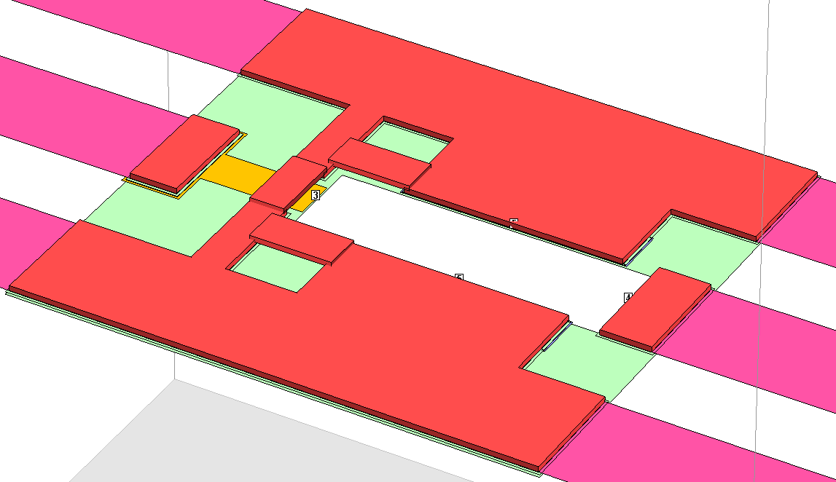
WIN 0.4μm GaN on Silicon 2x170μm 50v FET Measurement Reference Planes
2x170μm CPW FET
Gate
Source
Ref Planes
Drain
Source

Slide 4
WIN 0.4μm GaN on Silicon 6x170μm 50v FET Measurement Reference Planes
ADD slide

Slide 5
Measurement Summary
Below are the measurements that were done for the model extractions.
DC IV characteristics at (-40, 0, 25, 50, 100ºC baseplate)
DC IV’s are out to Vds=30v (Vgs = -4v to +2v, 0.25v steps)
Forward gate diode current (Vds = 0v, Igs = 1e-5 to 10mA/mm)
3-terminal gate leakage current (Vgs = -8v, Vds = 0v to 40v, 1v steps)
Drain current transfer sweep (Vds = 10v, Vgs = -5v to +2v, 0.1v steps)
We do not measure breakdown voltage (we don’t want to damage the devices that we are modeling). However, Vbr is measured in process ~250-300v and we can use that data for the model (however, this version of the models do not include breakdown).

Slide 6
Measurement Summary
Pulsed S-params at 2GHz (-40, 0, 25, 50, 100ºC baseplate)
Vdsq=50v, Vgsq=-3v, (Vds=0v to 60v, Vgs = -4v to +1v, 0.25v steps)
DC Pulse width = 2μs Period = 1000μs, RF pulse IF BW = 5MHz
We do direct extraction @ 2GHz to fit the nonlinear charges, Gm, Gds, and pulsed drain current IV curve, etc...
CW 0.1-26.5GHz S-parameters at (25ºC baseplate)
(Vds=50v, Ids = 5 to 30mA)
We use this data to fit the parasitic inductances Lg, Ld, Ls, Tau, Ri…
Gate and Drain lag measurements (-40, 0, 25, 50, 100ºC baseplate)
Gate lag - (Vds=10v fixed, Vgs is pulsed -10v to Ids~20mA/mm)
Drain lag - (Vgs fixed for Ids~20mA/mm, Vds is pulsed 50v to 10v)
We use a single step pulse and we capture the drain current response from 20μs to 2s.
We use this data to extract the gate and drain lag trap models.

Slide 7
Measurement Summary
In process PCM data (we have this data over temperature as well)
EPI sheet rho
Ohmic contact resistance
Gate metal sheet rho
We use this data to calculate the access resistances Rg, Rs, & Rd (including their temperature variation).

Slide 8
Model Verification
We used CW loadpull measurements on a 6x170μm CPW device at 2.5GHz for model verification.
CW loadpull measurements were at 2.5GHz (25ºC baseplate)
Vdsq=50v, Idsq ~ 20mA/mm Pin = small-signal to 3dB compression
Capture Pin, Pout, Gain, PAE, Ids, Igs

Slide 9
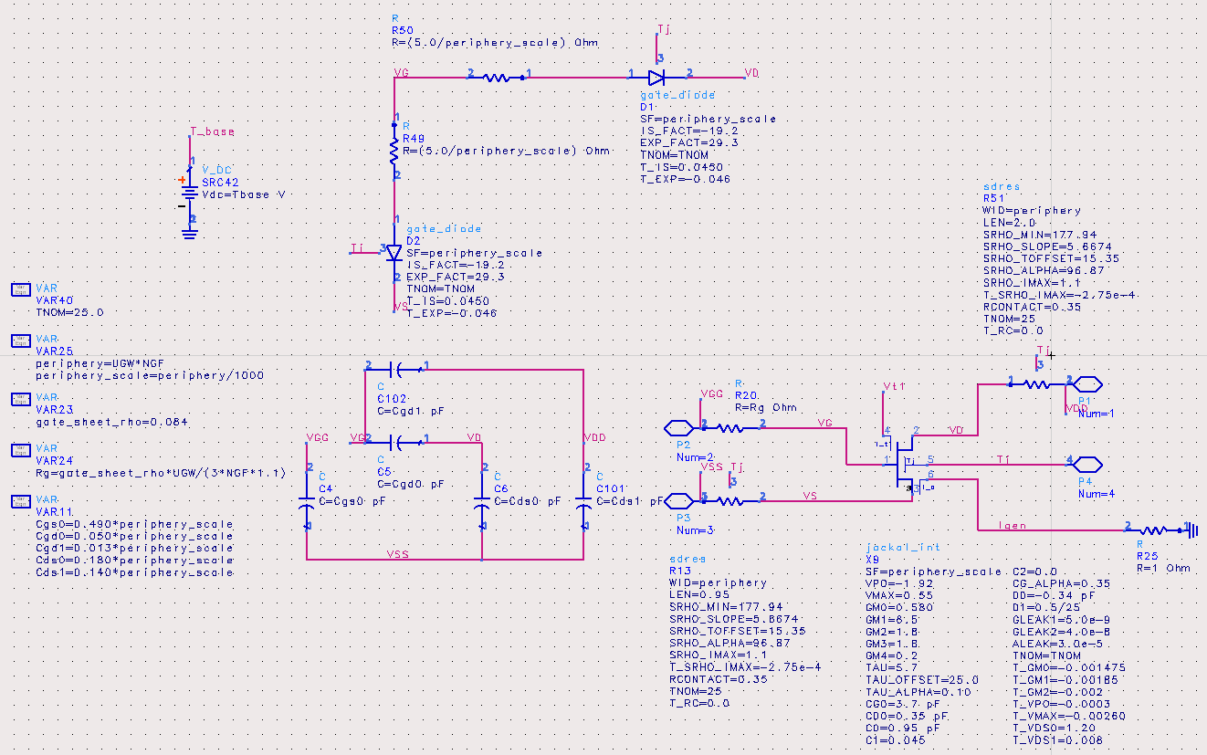
GaN on Silicon “Jackal” HEMT Model Topology
Gate
Drain
Tj
Source

Slide 10
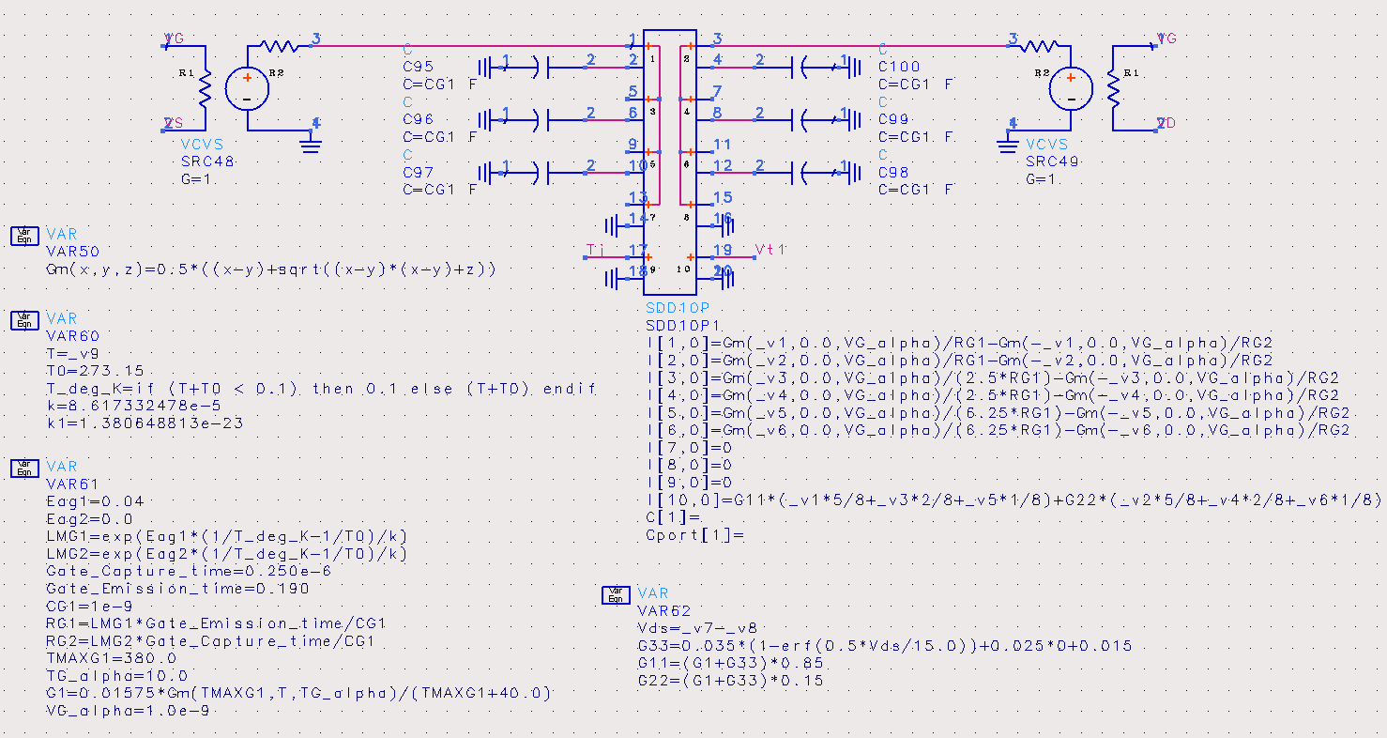
GaN on Silicon “Jackal” HEMT Model Topology Gate & Drain Lag Trap Models
Vgs_int
Vgd_int
Tj
Vtrap voltage out

Slide 11
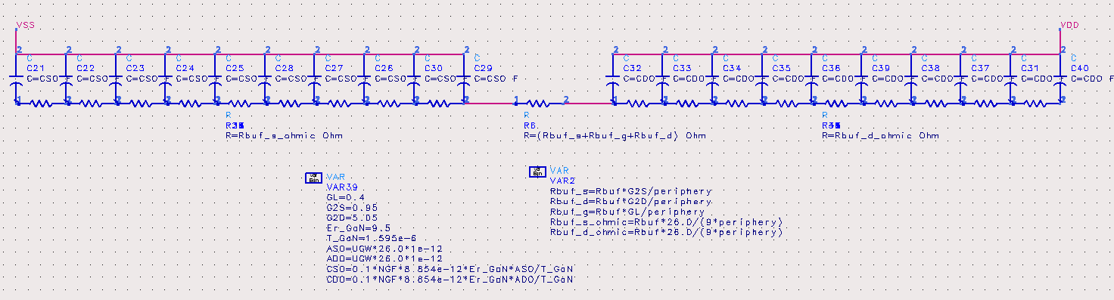
GaN on Silicon “Jackal” HEMT Model Topology Parasitic Buffer Resistance
gate
2-DEG
Source Ohmic
Drain Ohmic
AlGaN
GaN
Silicon
Parasitic Ga Layer
Source
Drain

Slide 12
Executive Summary
Jackal model for GaN on Silicon: (coded in Verilog-A)
supported in both ADS & AWR design software
Model features:
Model is scalable (unit gate width & number of gate fingers)
Full nonlinear model (can be run in linear or nonlinear modes)
Includes thermal node (to connect to a thermal network)
Includes extra Ids current node (for dynamic loadline analysis)
Includes gate and drain lag trapping behavior
Full temperature dependence of nonlinear drain current, gate charge, trap behavior, leakage currents, and access resistances)
Includes the affect of parasitic buffer resistance (fixed versus temperature for now)
Breakdown current not included (in this model version)
Thermal network model for GaN on Silicon is included in the kits.

Slide 13
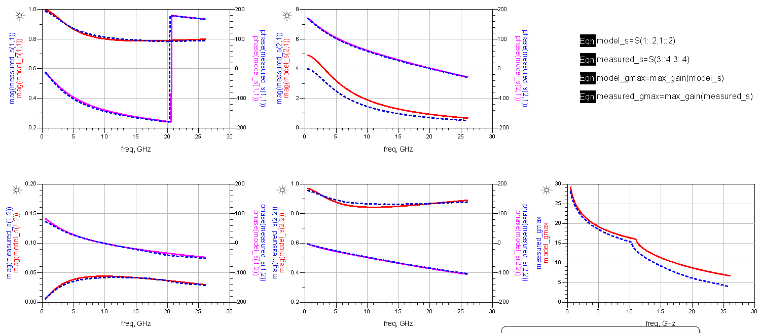
S-Parameter Fit (Vds=50v Ids=5mA) 2x170μm CPW FET

Slide 14
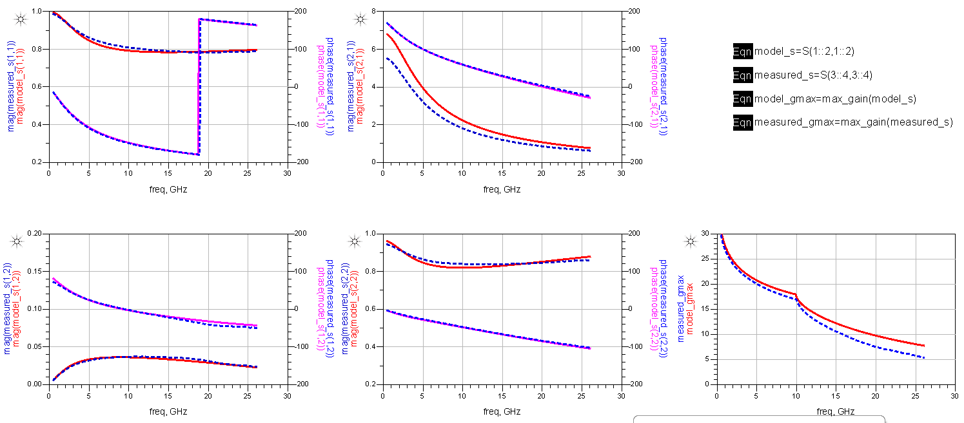
S-Parameter Fit (Vds=50v Ids=10mA) 2x170μm CPW FET

Slide 15
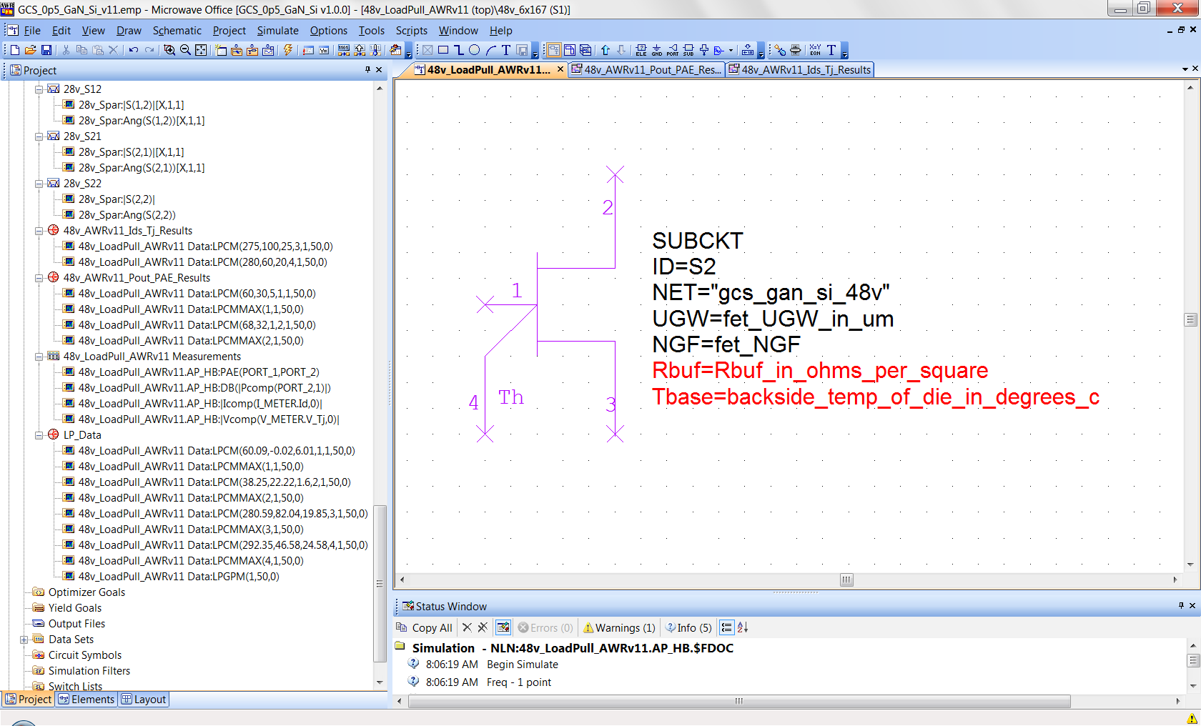
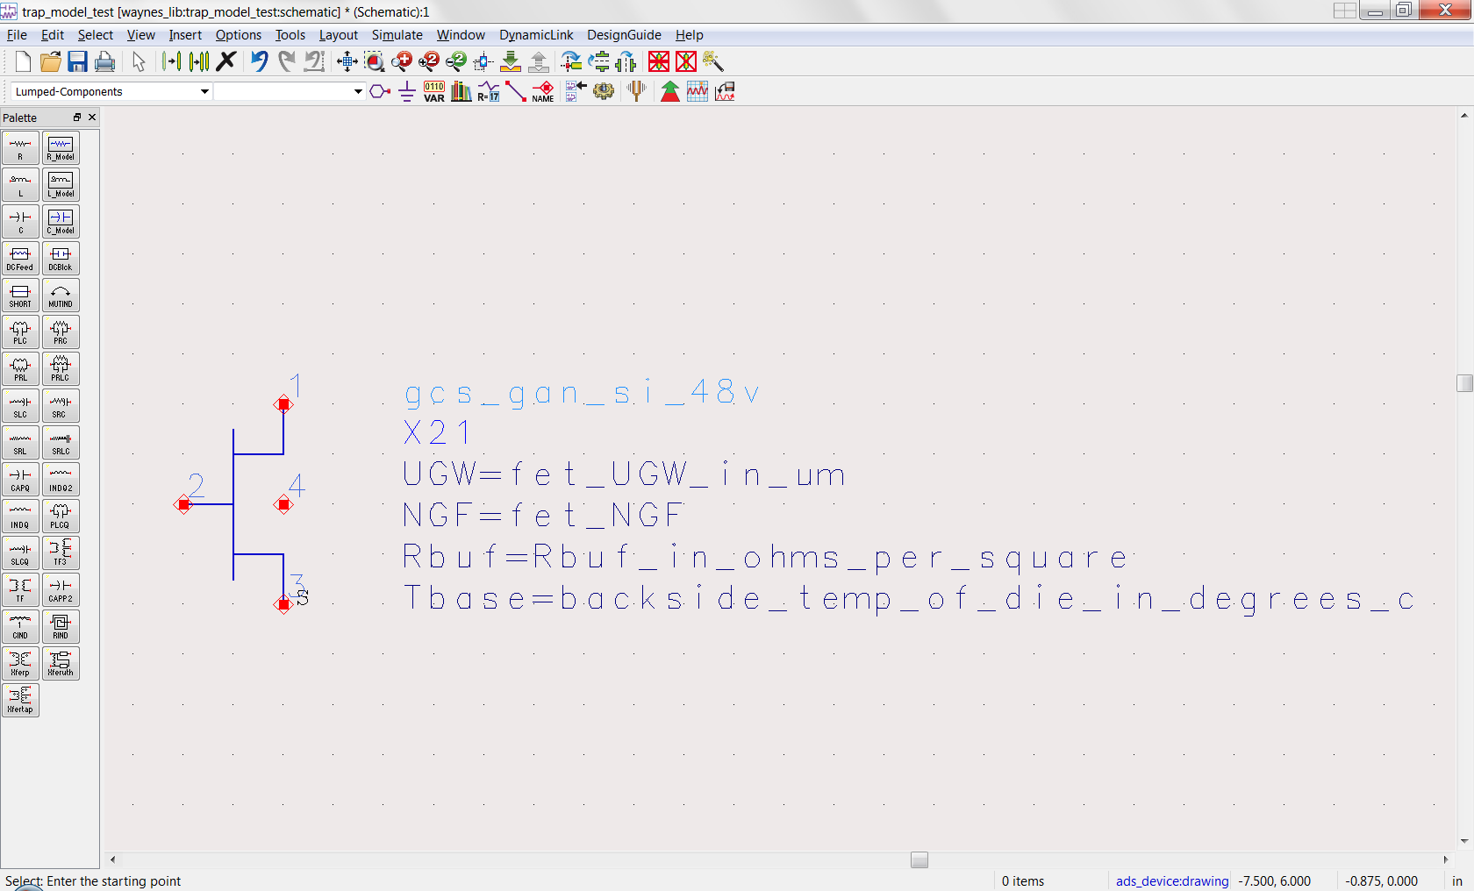
GaN on Silicon “Jackal” Intrinsic HEMT Models
AWR
ADS

Slide 16
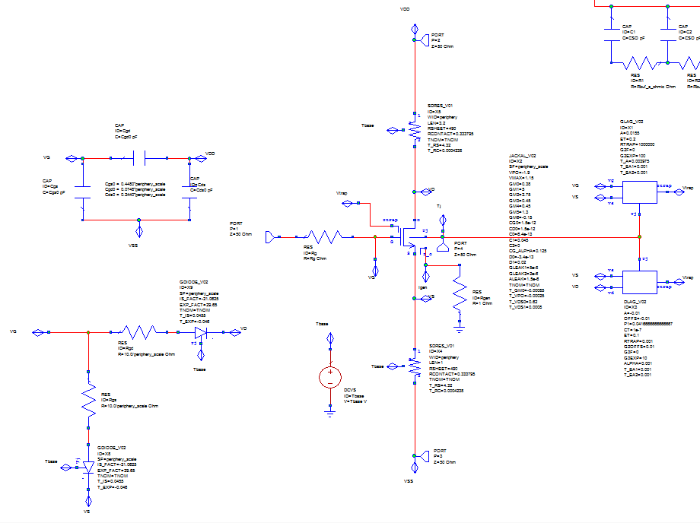
GaN on Silicon “Jackal” Intrinsic HEMT Model
AWR
Rd model
fixed metal capacitances
gate lag model
Intrinsic
Jackal
model
gate Schottky
model
drain lag model
Rs model

Slide 17
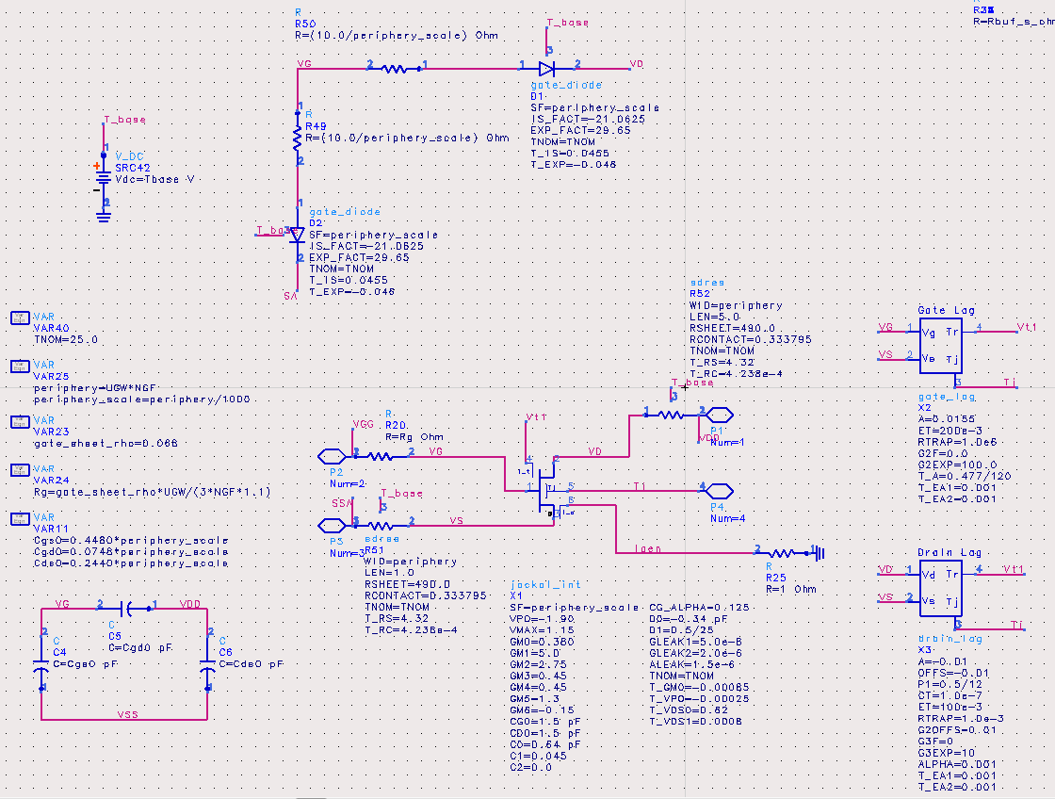
GaN on Silicon “Jackal” Intrinsic HEMT Model
ADS

Slide 18
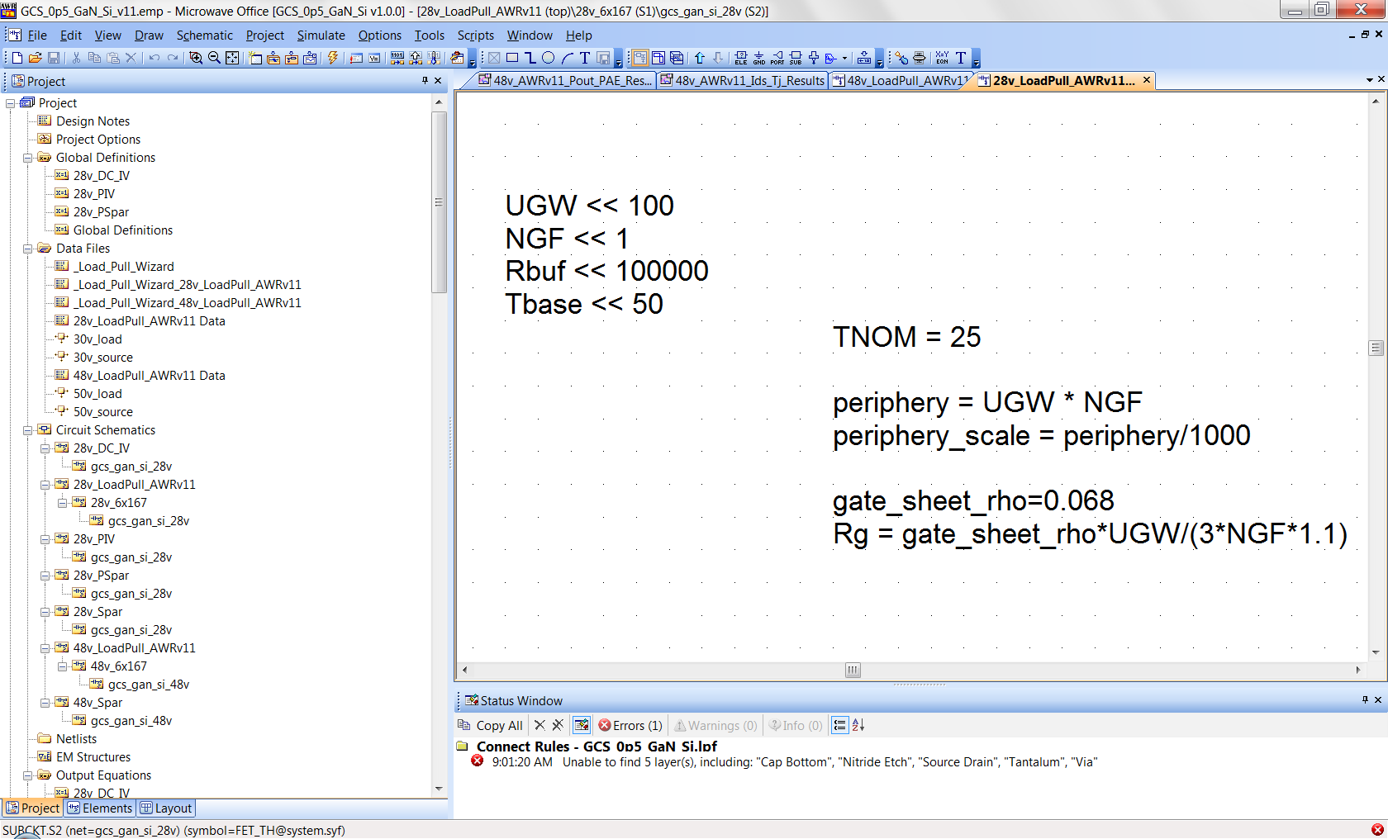
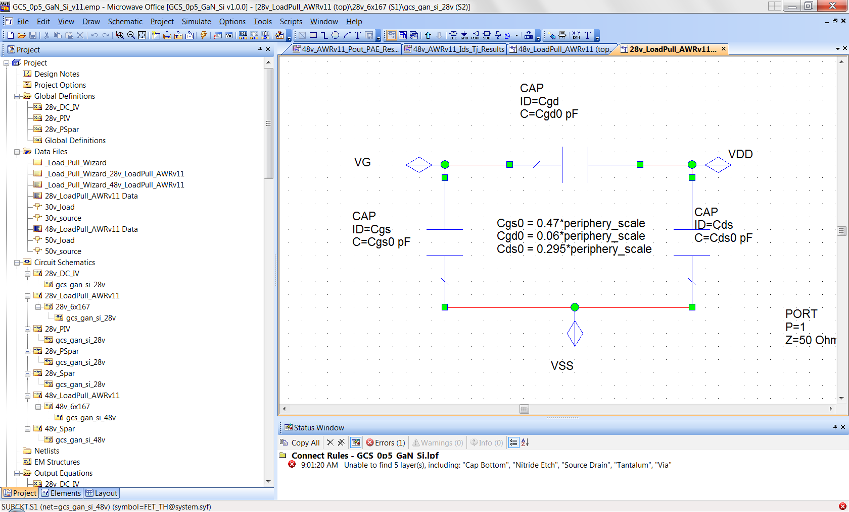
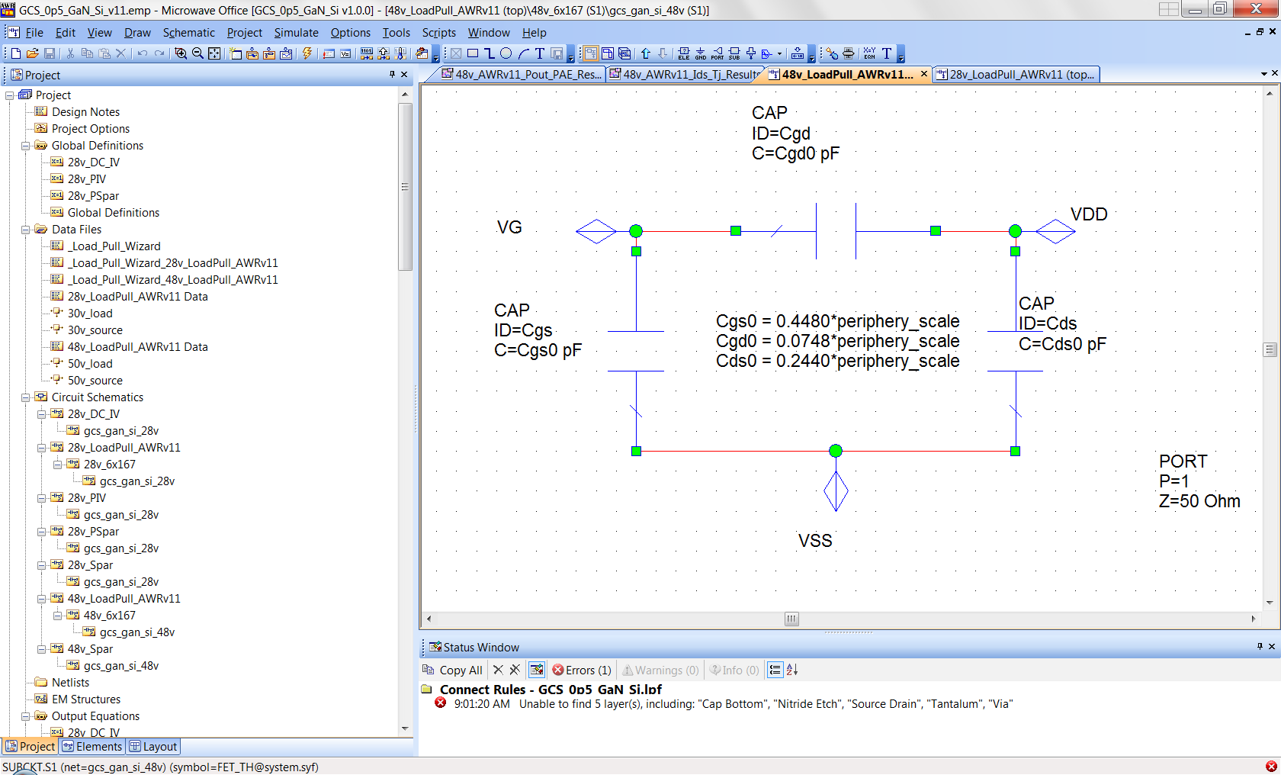
Jackal Model Parameter Values (fixed capacitances)
28v Model
50v Model

Slide 19
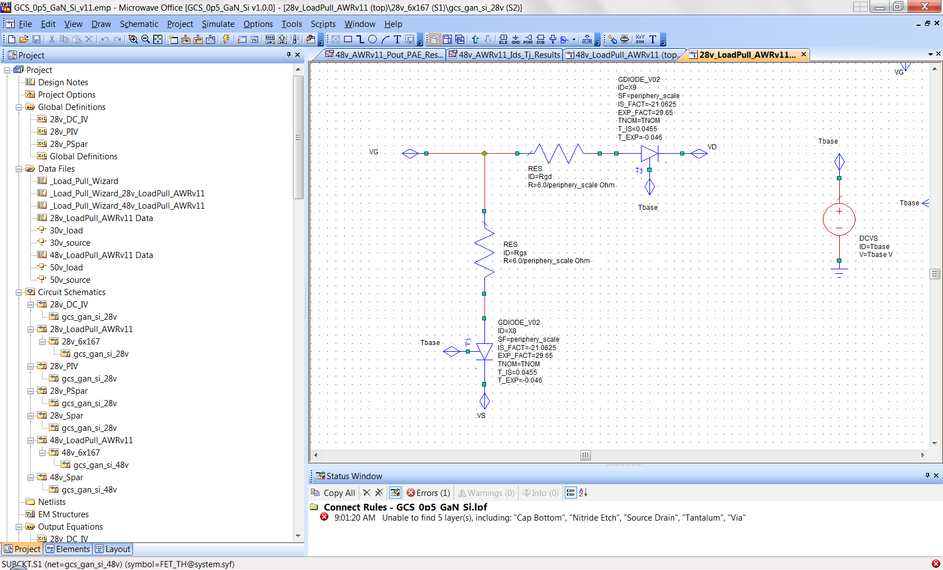
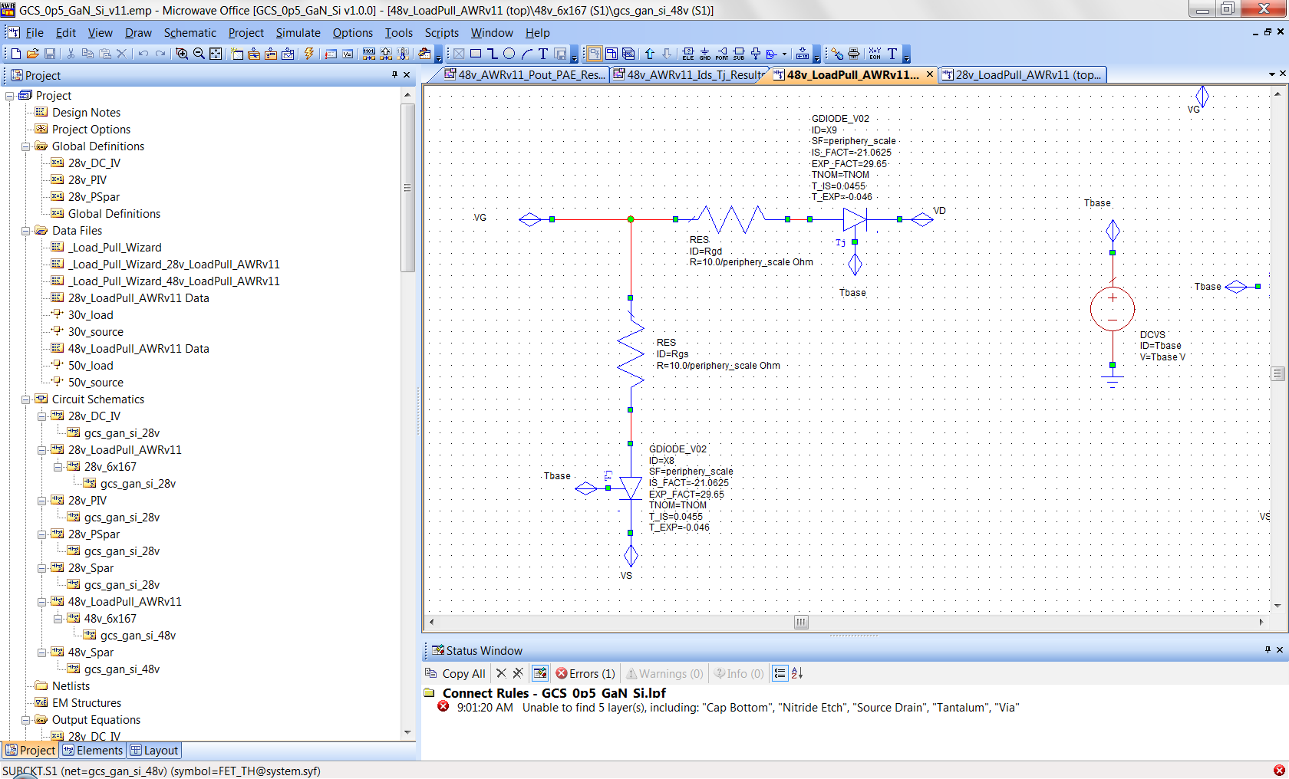
Jackal Model Parameter Values (gate schottky diode)
28v Model
50v Model

Slide 20
Jackal Model Parameter Values (access resistors Rs & Rd)
GaN EPI Sheet Rho 4.32 Ω/sq / ºC

Slide 21
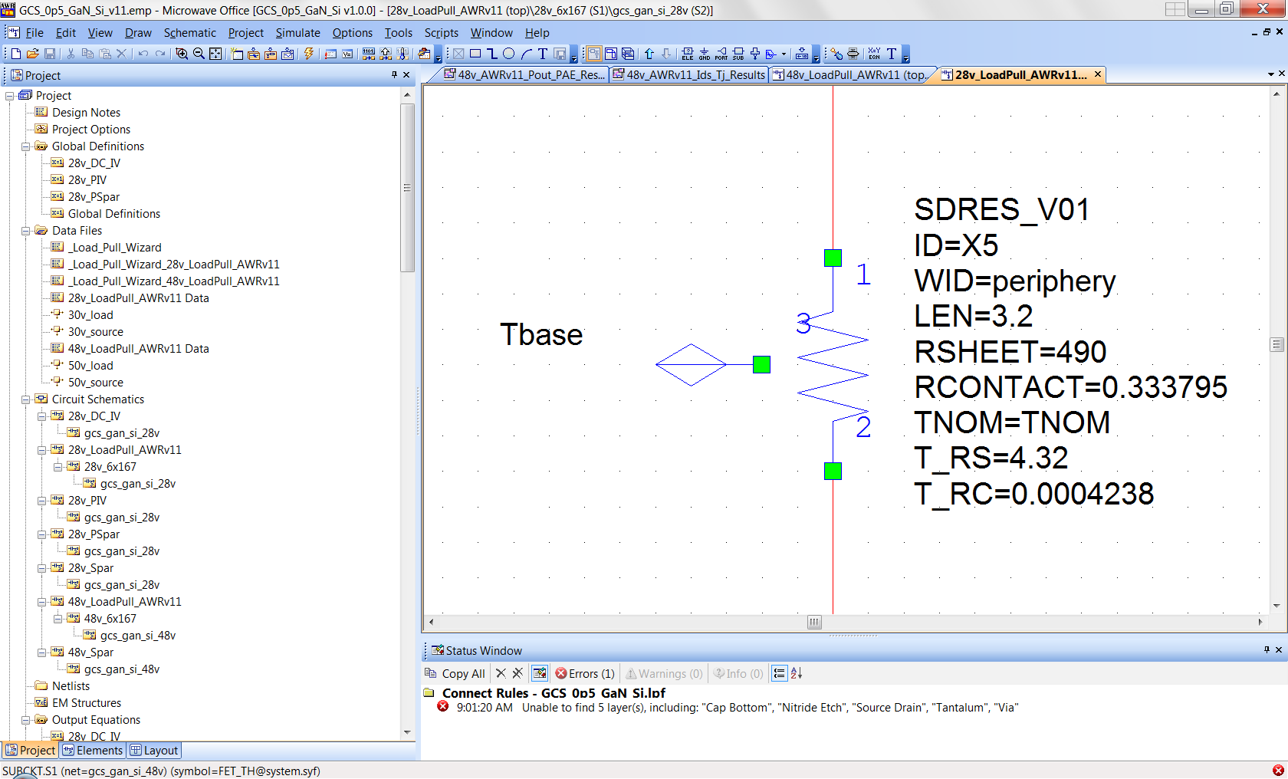
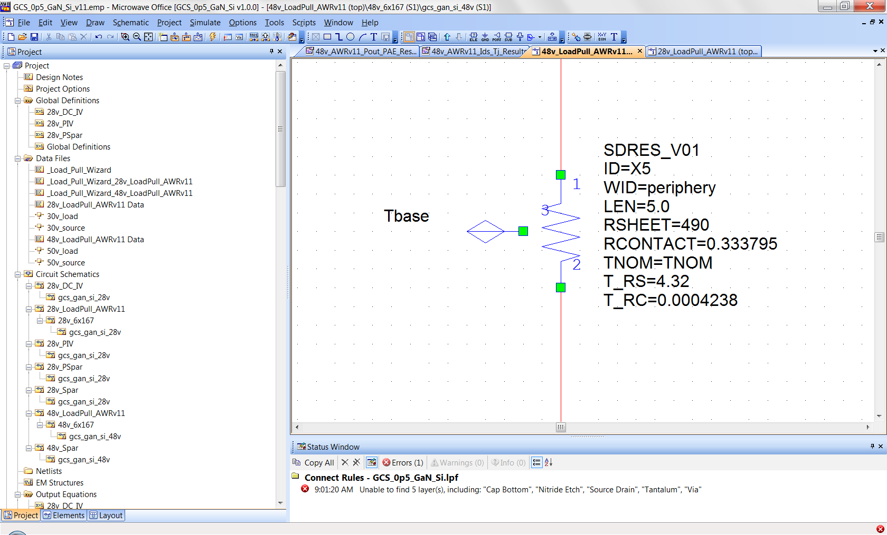
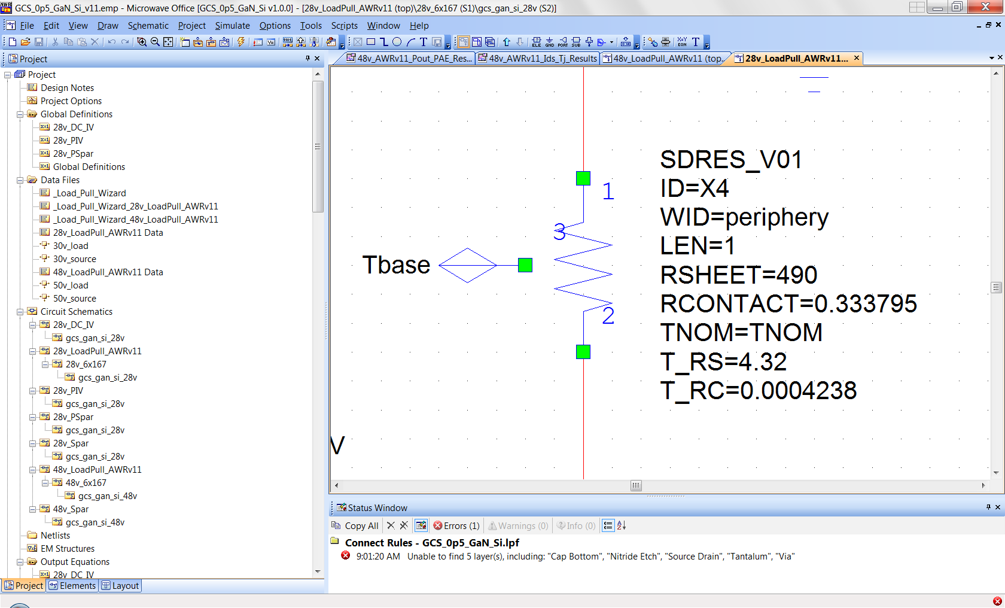
Jackal Model Parameter Values (access resistors Rs & Rd)
28v Model Rd
50v Model Rd
28v Model Rs
50v Model Rs

Slide 22
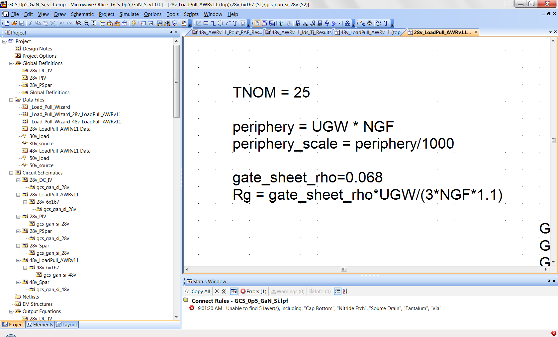
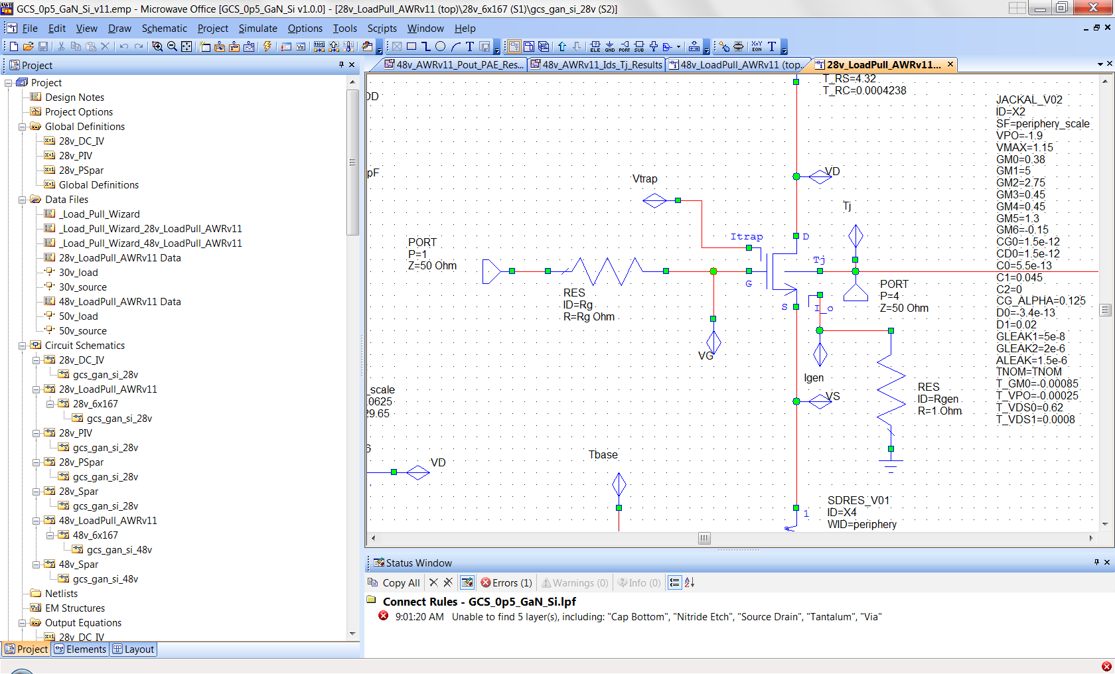
Jackal Model Parameter Values (access resistor Rg)
28v & 50v Models Rg

Slide 23
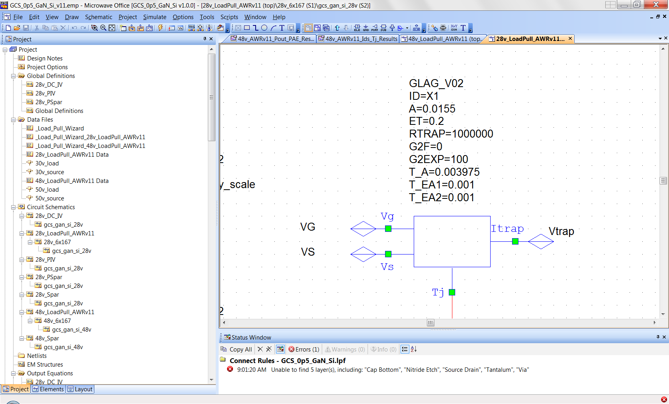
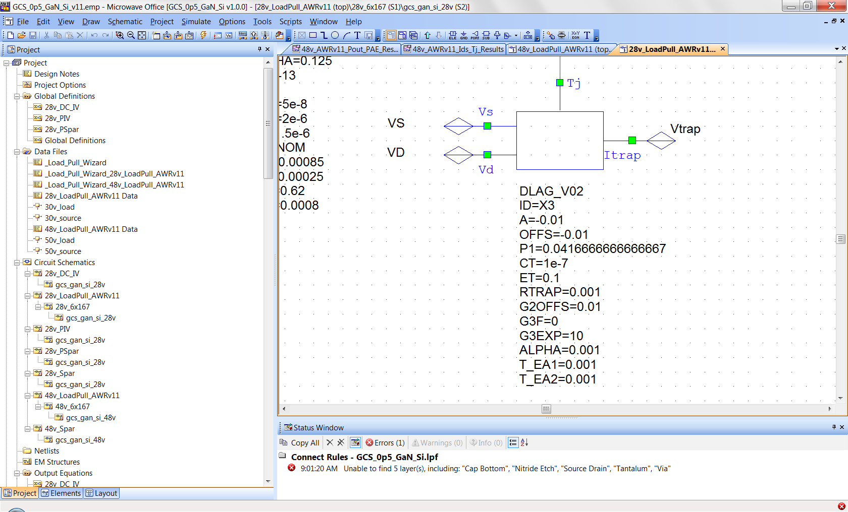
Jackal Model Parameter Values (gate and drain lag)
28v & 50v Models Gate Lag
28v & 50v Models Drain Lag

Slide 24
GaN on Silicon Parasitic Buffer Resistance Model Concept
gate
2-DEG
Source Ohmic
Drain Ohmic
AlGaN
GaN
Silicon
Parasitic Ga Layer

Slide 25
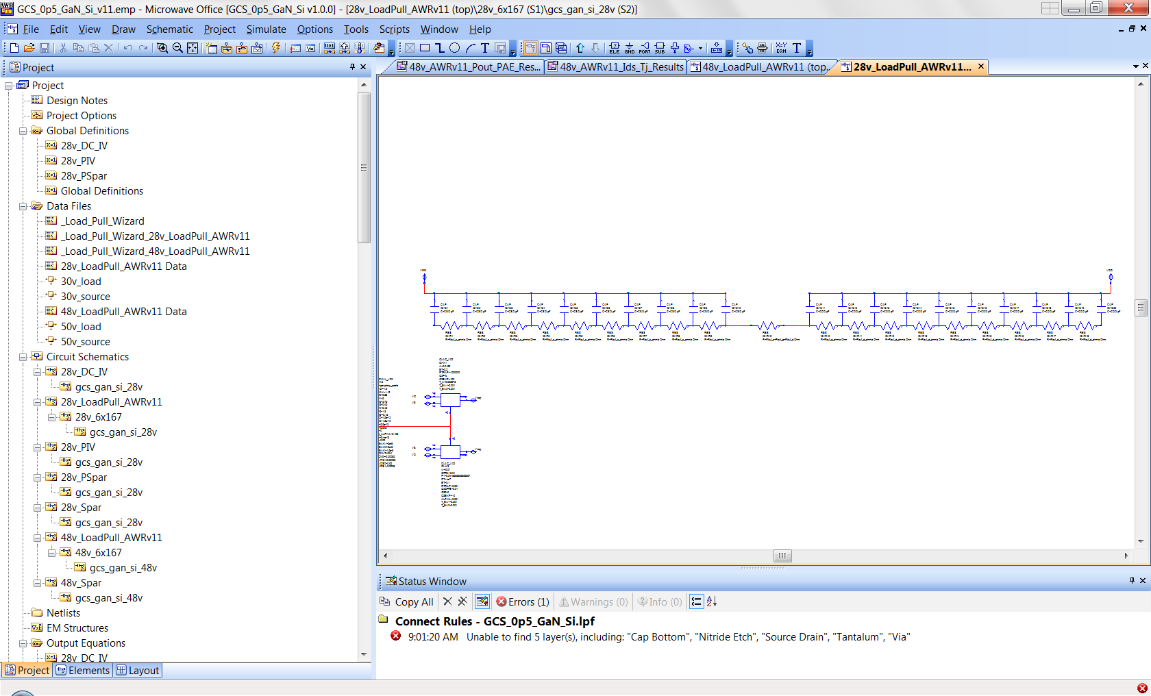
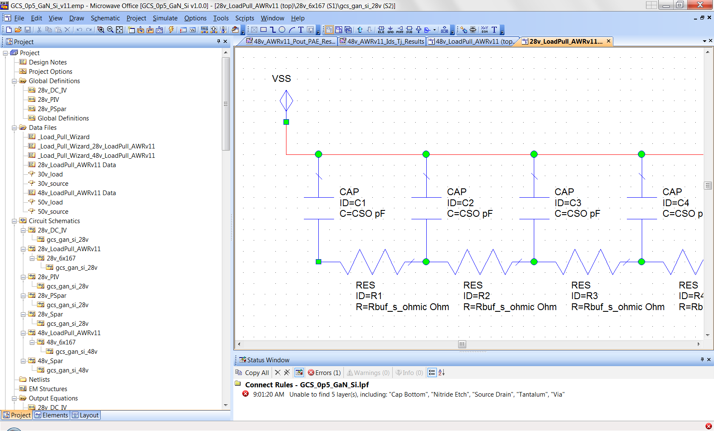
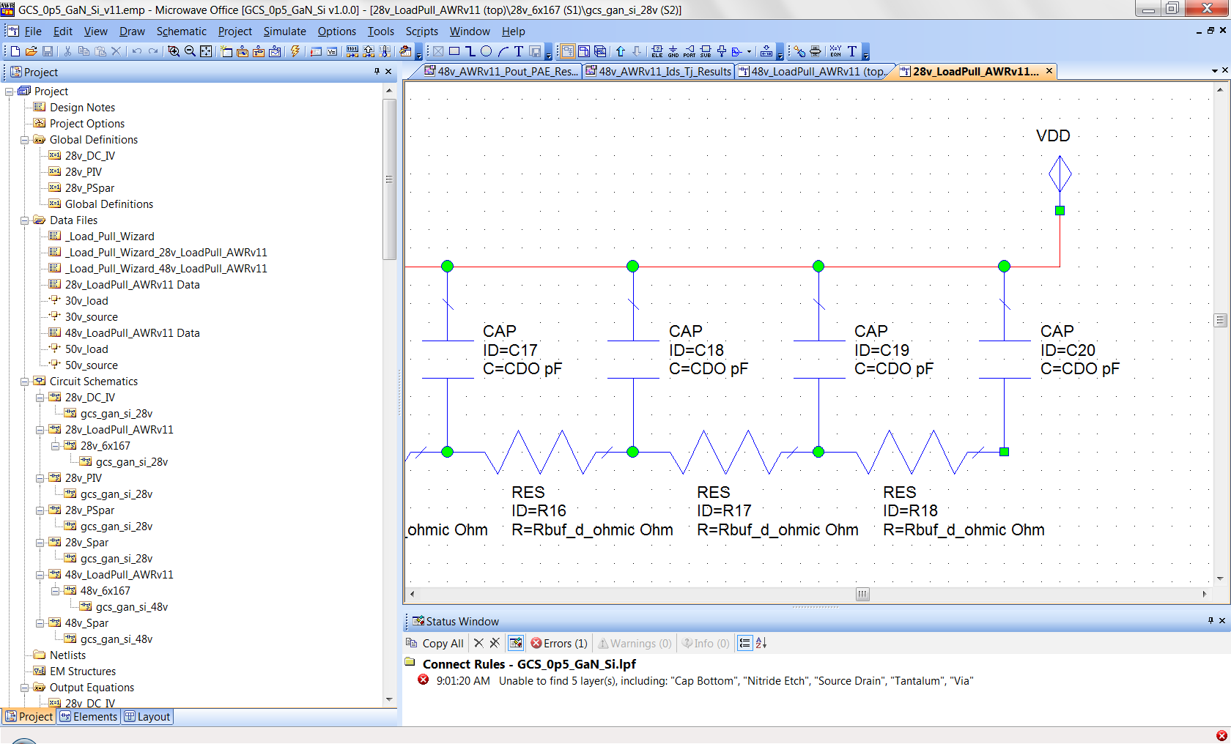
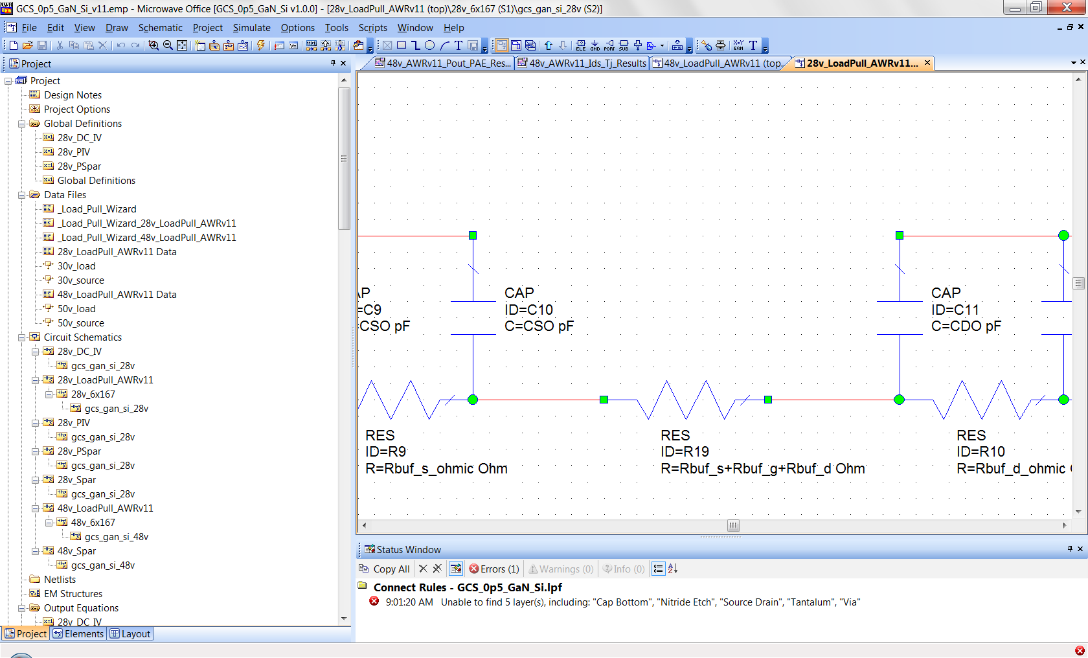
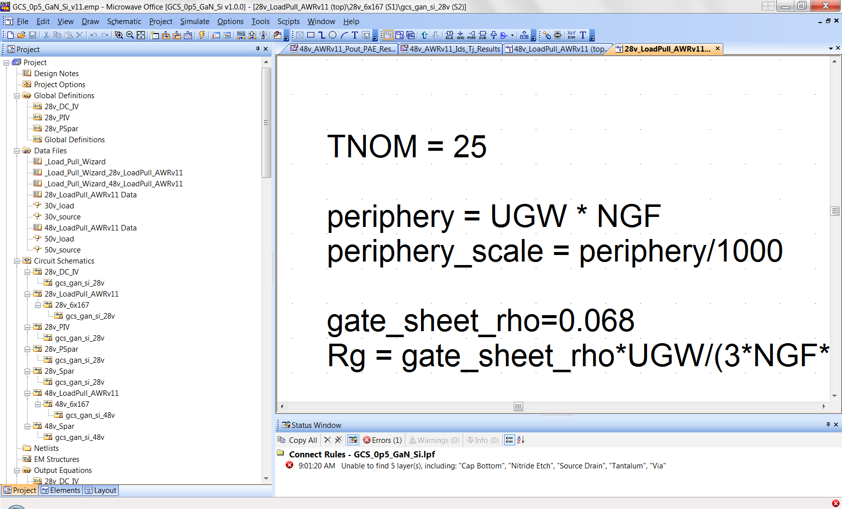
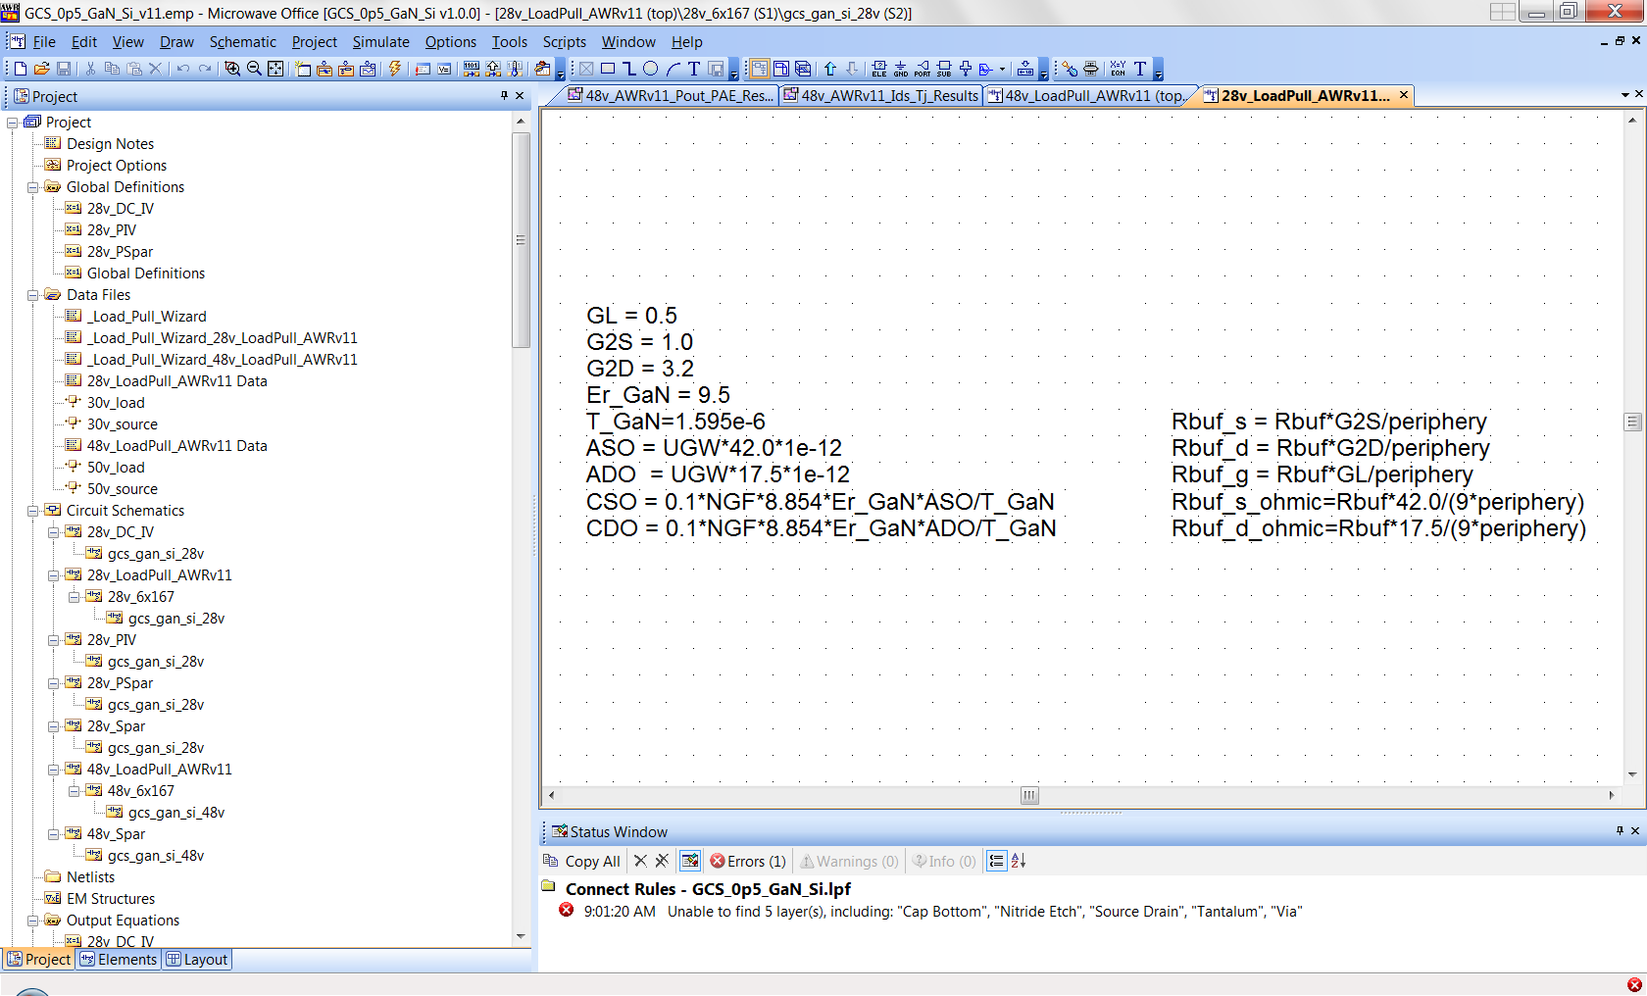
GaN on Silicon Parasitic Buffer Resistance Models
extrinsic Vs
extrinsic Vd
5.0 for 50v
model
Rbuf varies across wafer
and process. Typical values
range from 1e5 to 2e5 Ω/sq
(verification used 2e5Ω/sq)

Slide 26
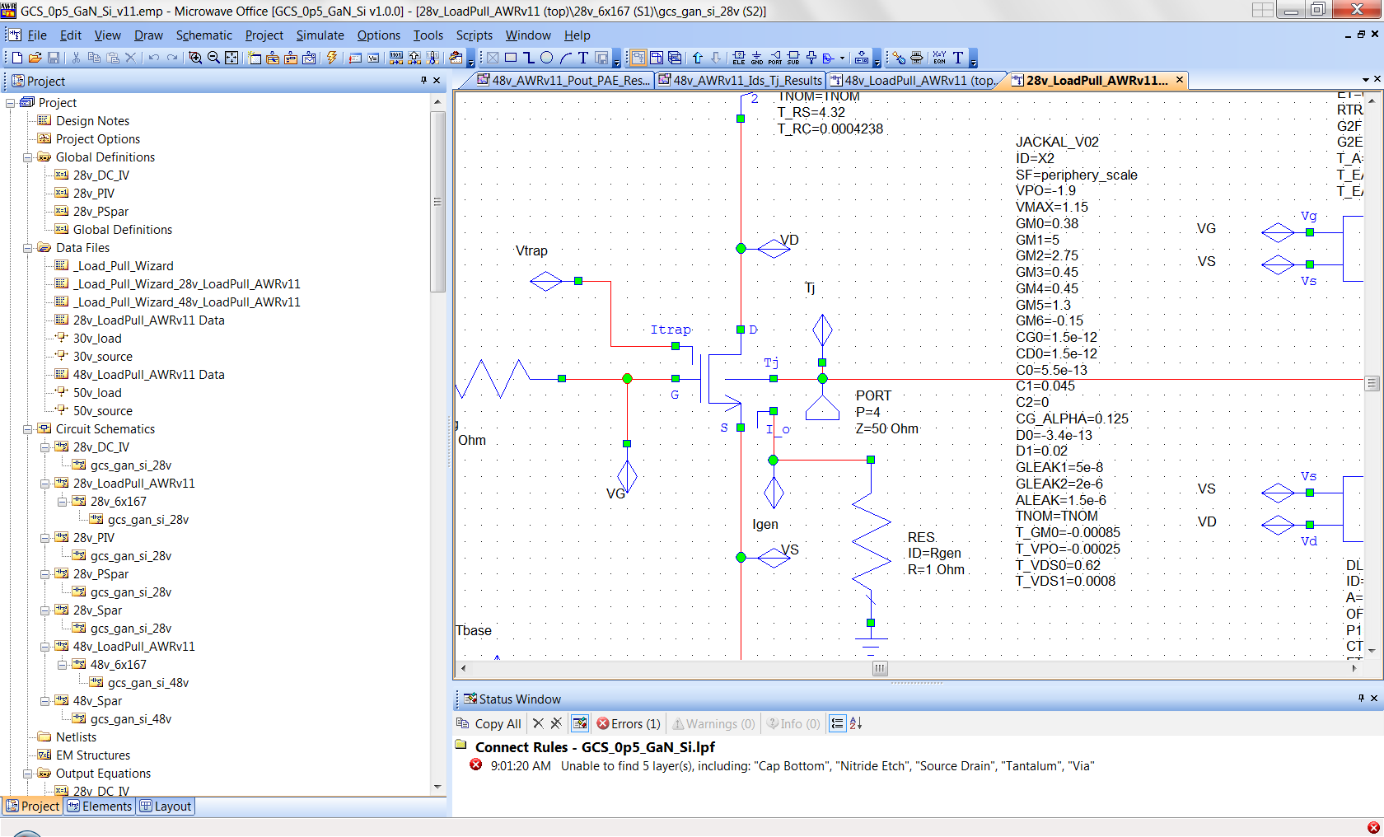
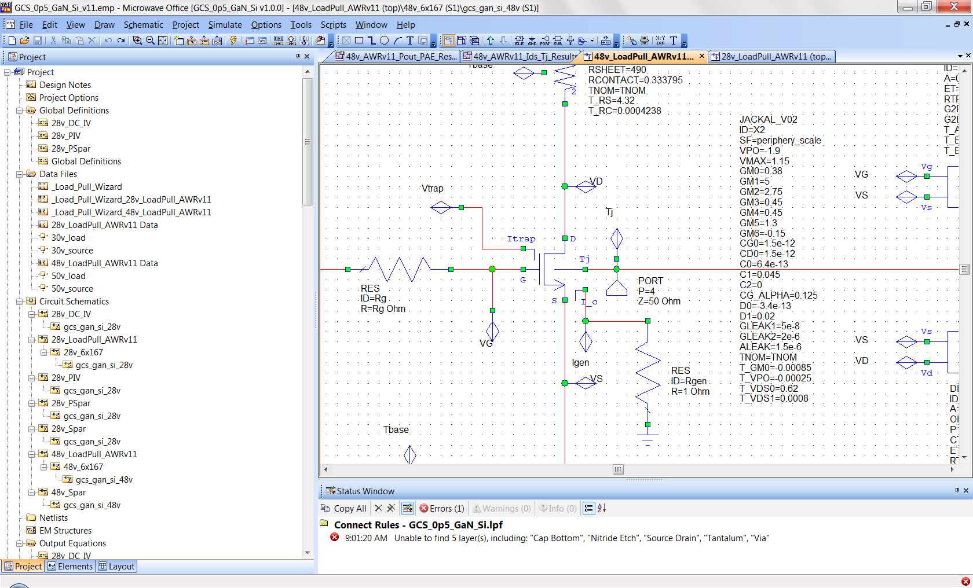
Jackal Model Parameter Values (intrinsic HEMT)
28v Model
50v Model

Slide 27
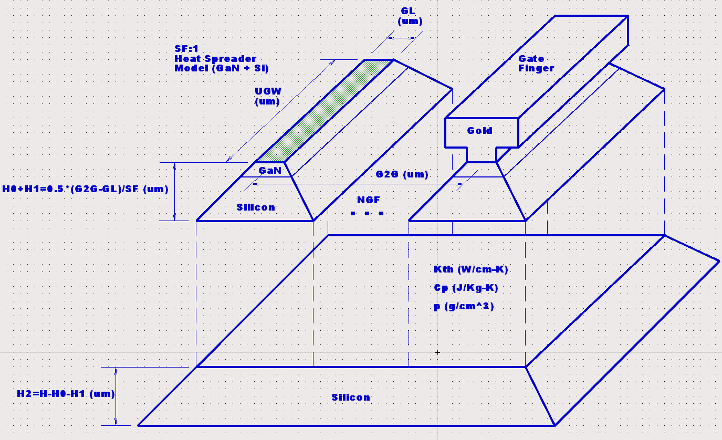
GaN on Silicon Thermal Resistance Model

Slide 28
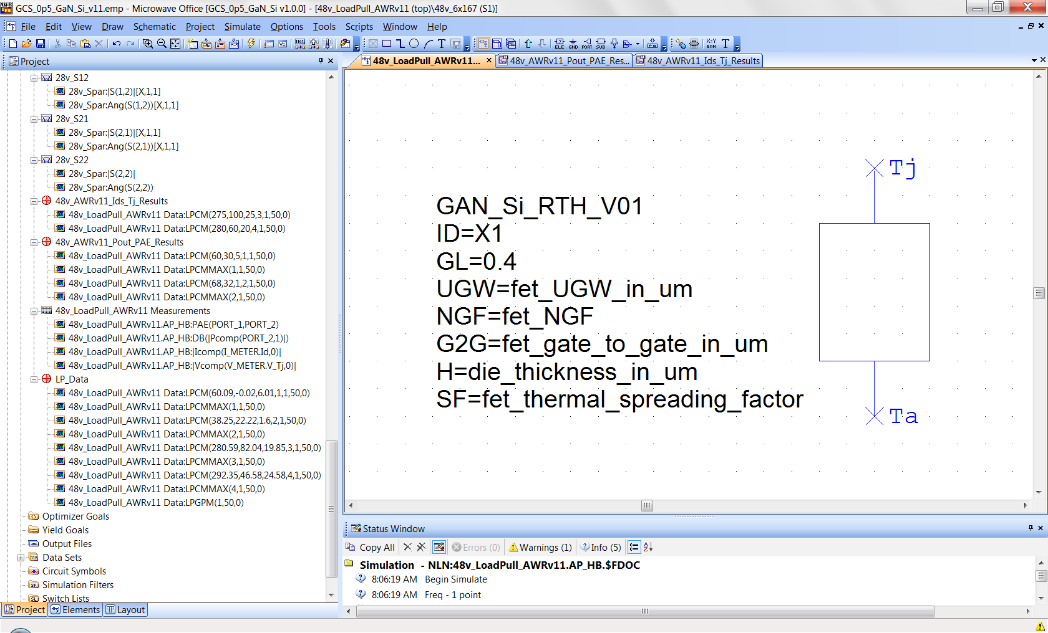
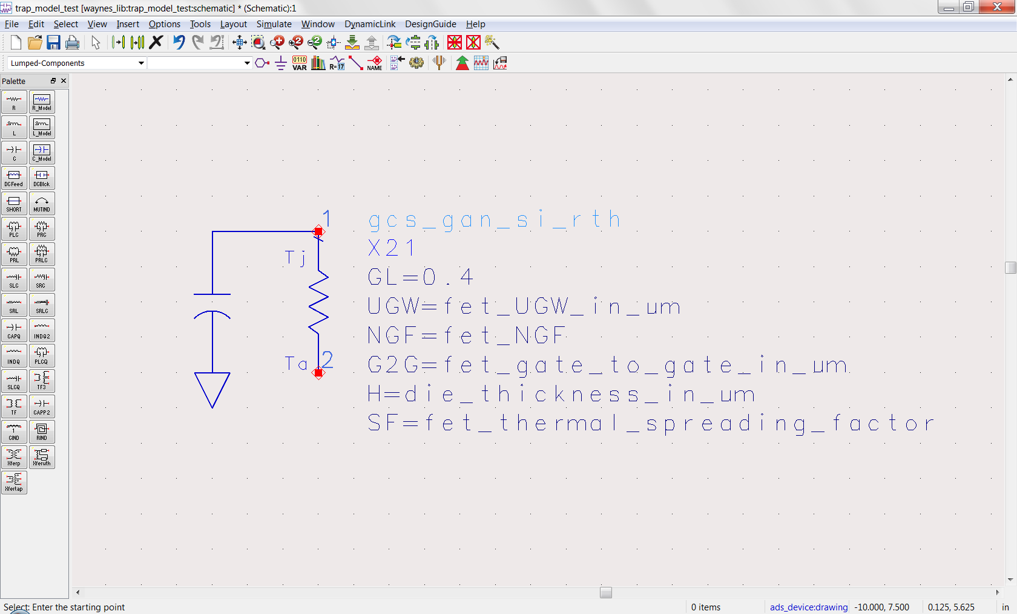
GaN on Silicon Thermal Resistance Model
AWR
ADS

Slide 29
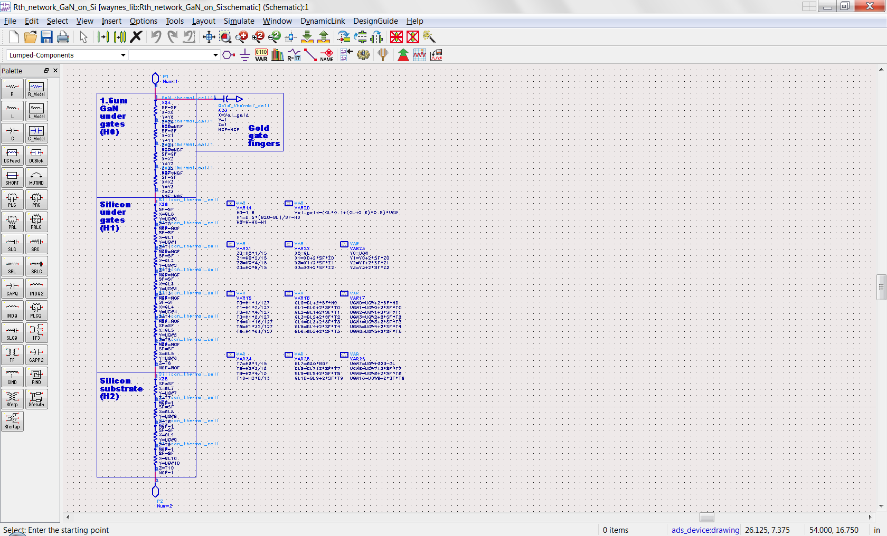
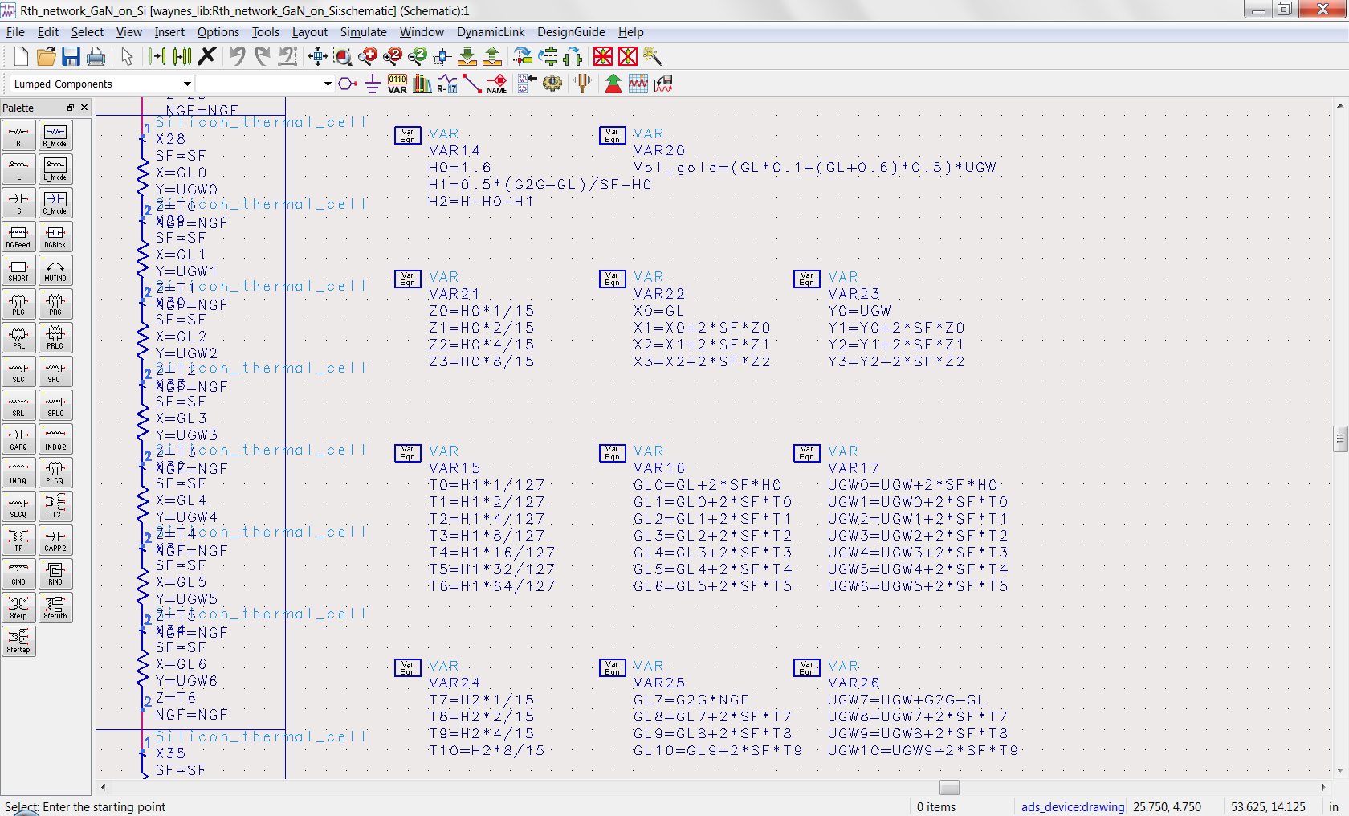
GaN on Silicon Thermal Resistance Model
ADS & AWR Kit Models
Are coded in Verilog-A
ADS “SDD” Model

Slide 30
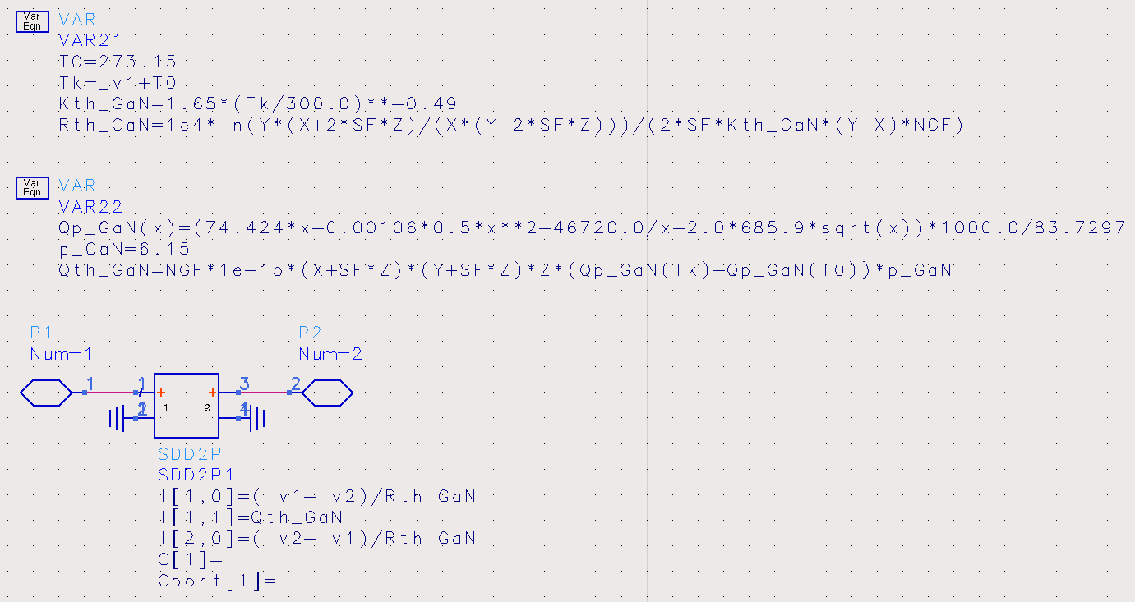
GaN Thermal Cell Model
ADS & AWR Kit Models
Are coded in Verilog-A
ADS “SDD” Model

Slide 31
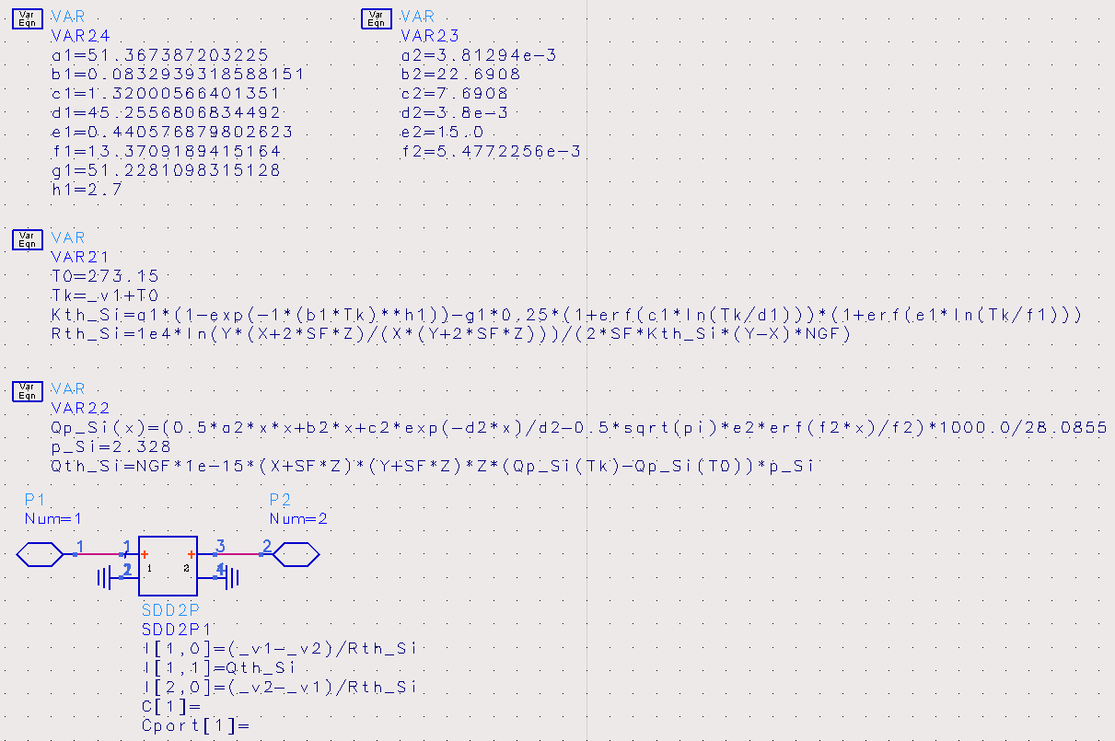
Silicon Thermal Cell Model
ADS & AWR Kit Models
Are coded in Verilog-A
ADS “SDD” Model

Slide 32
Silicon Thermal Cell Model (fit versus NIST Data)
Thermal Conductivity of Silicon
Specific Heat Capacity of Silicon

Slide 33
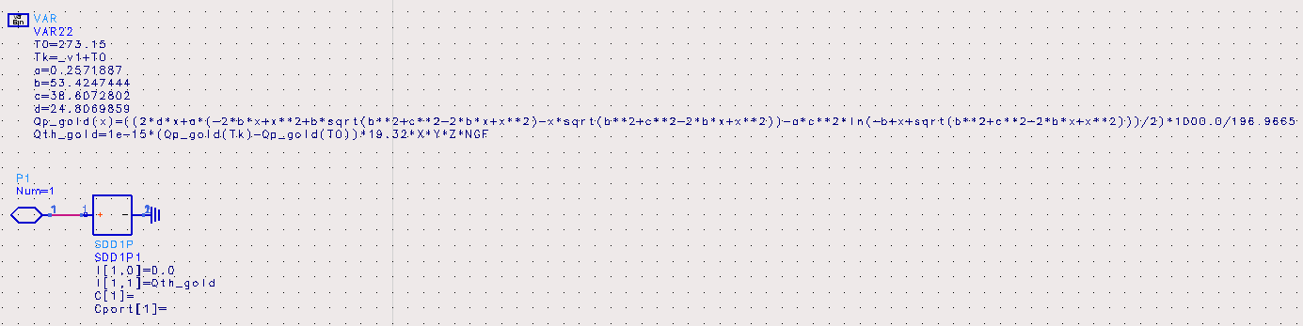
Gold Thermal Cell Model (specific heat capacity only)
ADS & AWR Kit Models
Are coded in Verilog-A
ADS “SDD” Model

Slide 34
Gold Thermal Cell Model (fit versus NIST Data)

Slide 35
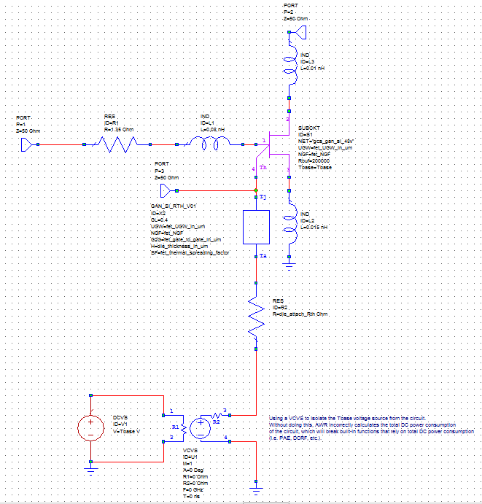
Jackal Model Use (for multi-finger transistor cells)
Must add extrinsic elements
to intrinsic Jackal subcircuit model
Ld
Lg & Ri
i=Pdiss
port voltage = Tj
Ls
die attach
and package
thermal models
use VCVS so AWR
gets PAE calculation
correct (source power = 0)
i=0
Tbase = baseplate temp

Slide 36
Jackal Model Verification (DC IV’s -40ºC baseplate) GCS 0.4μm GaN on Silicon 2x200μm 28v HEMT

Slide 37
Jackal Model Verification (DC IV’s 0ºC baseplate) GCS 0.4μm GaN on Silicon 2x200μm 28v HEMT

Slide 38
Jackal Model Verification (DC IV’s 25ºC baseplate) GCS 0.4μm GaN on Silicon 2x200μm 28v HEMT

Slide 39
Jackal Model Verification (DC IV’s 50ºC baseplate) GCS 0.4μm GaN on Silicon 2x200μm 28v HEMT

Slide 40
Jackal Model Verification (DC IV’s 100ºC baseplate) GCS 0.4μm GaN on Silicon 2x200μm 28v HEMT

Slide 41
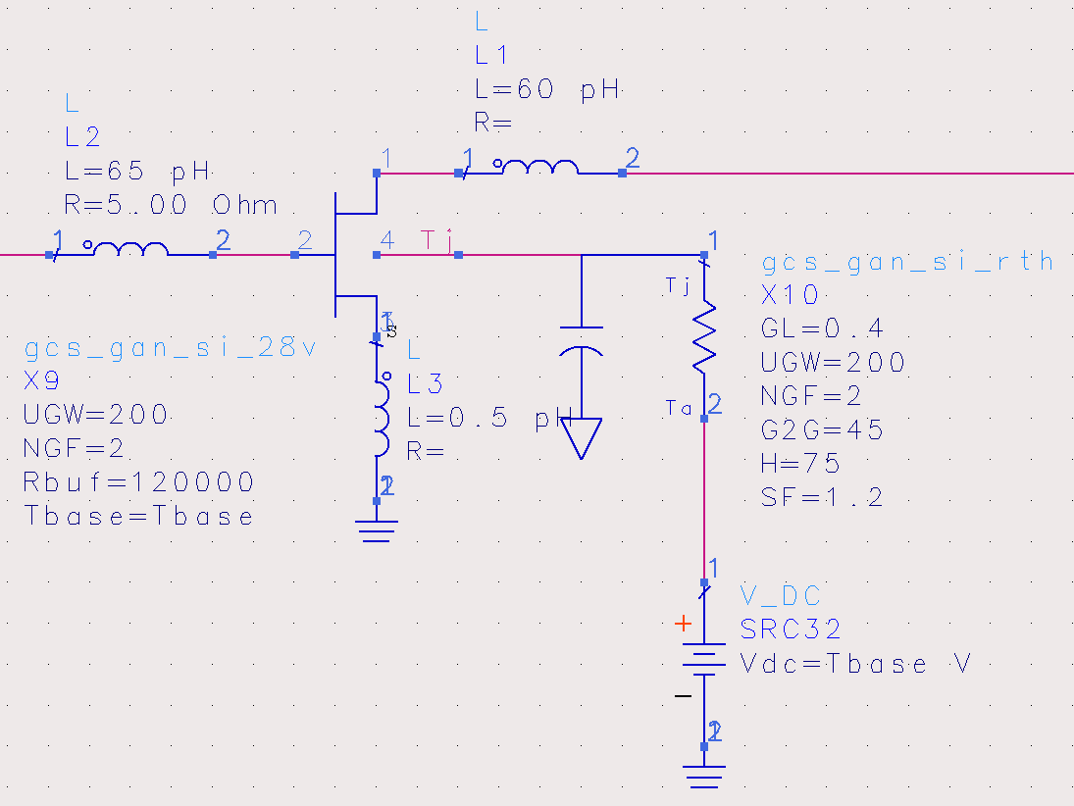
Jackal Model Verification (S-parameters 25ºC baseplate) GCS 0.4μm GaN on Silicon 2x200μm 28v HEMT (Vds=30v Ids=20mA)

Slide 42
Jackal Model Verification (S-parameters 25ºC baseplate) GCS 0.4μm GaN on Silicon 2x200μm 28v HEMT (Vds=30v Ids=20mA)
S11
S21
S12
S22

Slide 43
Jackal Model Verification (S-parameters 25ºC baseplate) GCS 0.4μm GaN on Silicon 2x200μm 50v HEMT (Vds=50v Ids=20mA)
S11
S21
S12
S22

Slide 44
1GHz Pulsed S-param Extract (Vdsq=30v Vgsq=-3v) GCS 0.4μm GaN on Silicon 2x200μm 28v HEMT Tbase=25ºC
pF/mm
Jackal Model
mS/mm
Vgs_pulse=-4v to 1v
0.25v steps
Measured
Vgs_pulse=-4v to 1v
0.25v steps

Slide 45
1GHz Pulsed S-param Extract (Vdsq=30v Vgsq=-3v) GCS 0.4μm GaN on Silicon 2x200μm 28v HEMT Tbase=25ºC
pF/mm
Jackal Model
mS/mm
Vgs_pulse=-4v to 1v
0.25v steps
Measured
Vgs_pulse=-4v to 1v
0.25v steps

Slide 46
1GHz Pulsed S-param Extract (Vdsq=30v Vgsq=-3v) GCS 0.4μm GaN on Silicon 2x200μm 28v HEMT Tbase=25ºC
pF/mm
Jackal Model
Vgs_pulse=-4v to 1v
0.25v steps
Measured
Vgs_pulse=-4v to 1v
0.25v steps

Slide 47
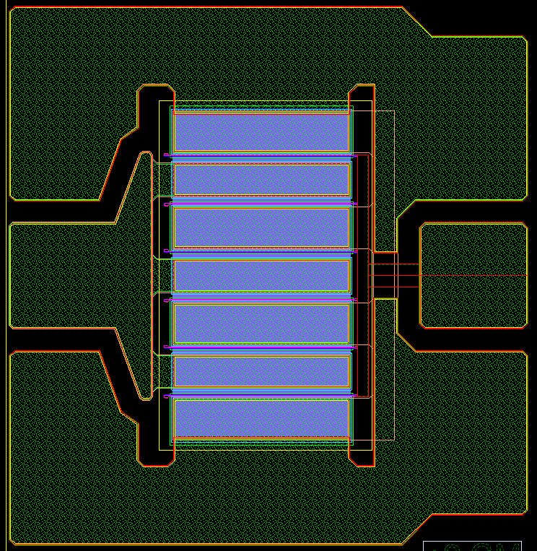
GCS 0.4μm GaN on Silicon 6x167μm 50v HEMT
50v GD5 Device
Drain
Gate
Ref Plane
Ref Plane

Slide 48
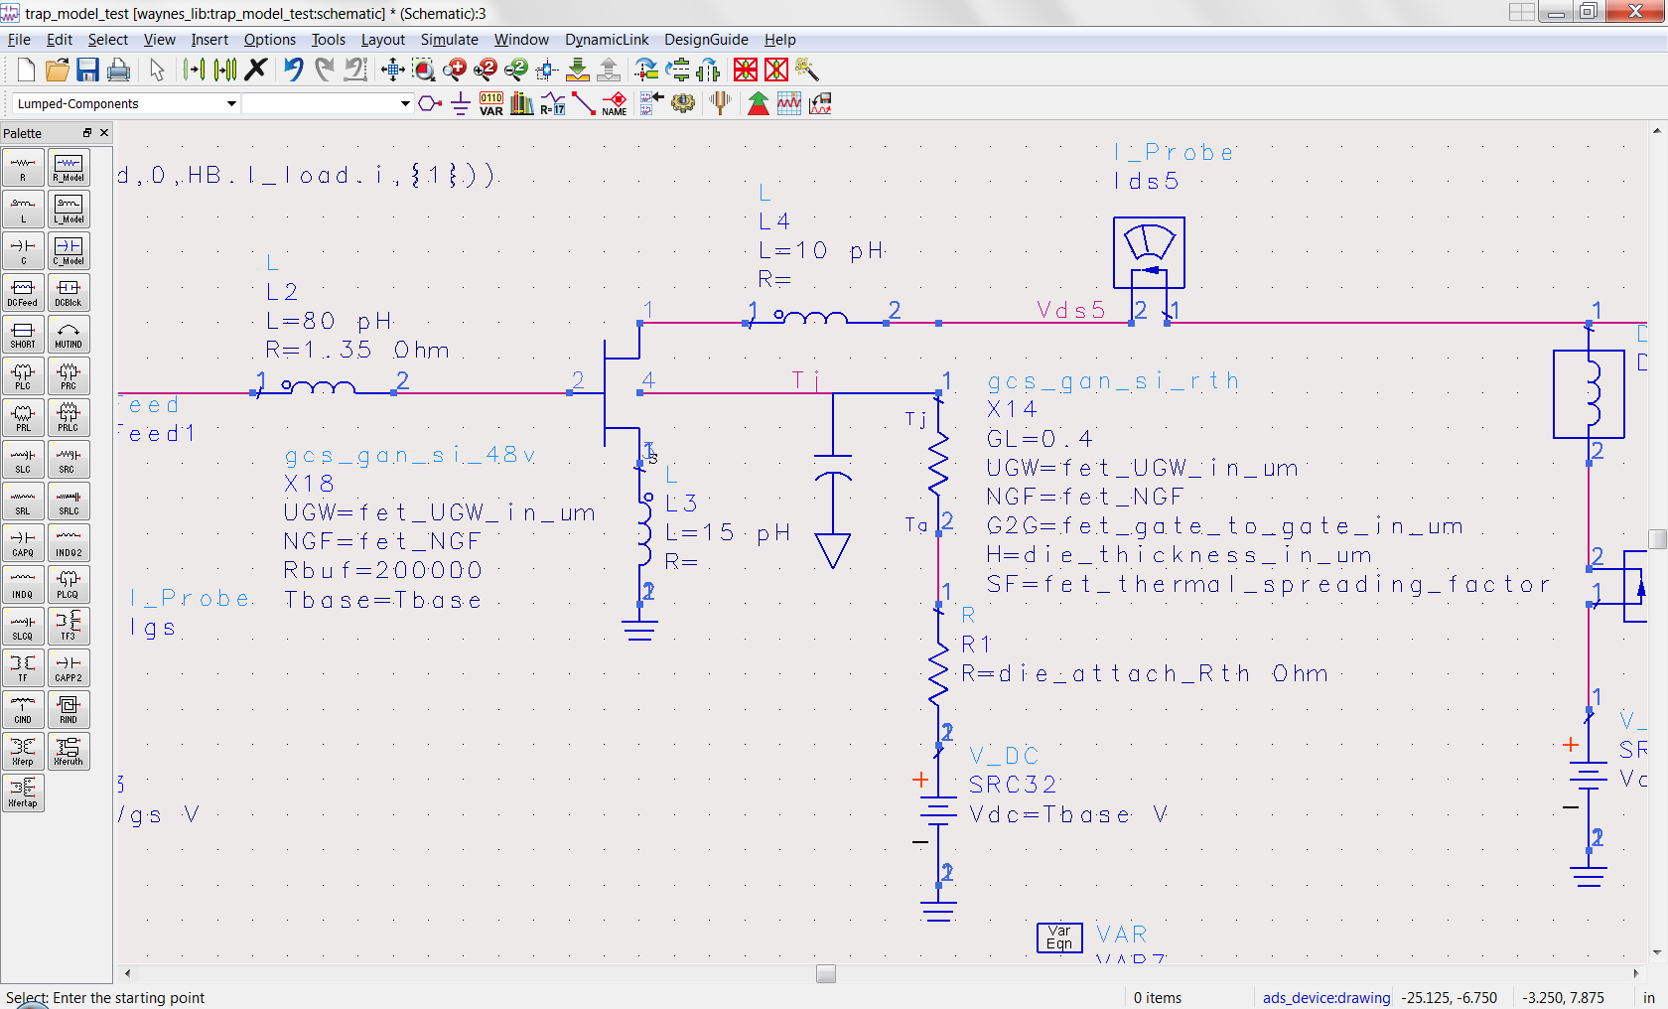
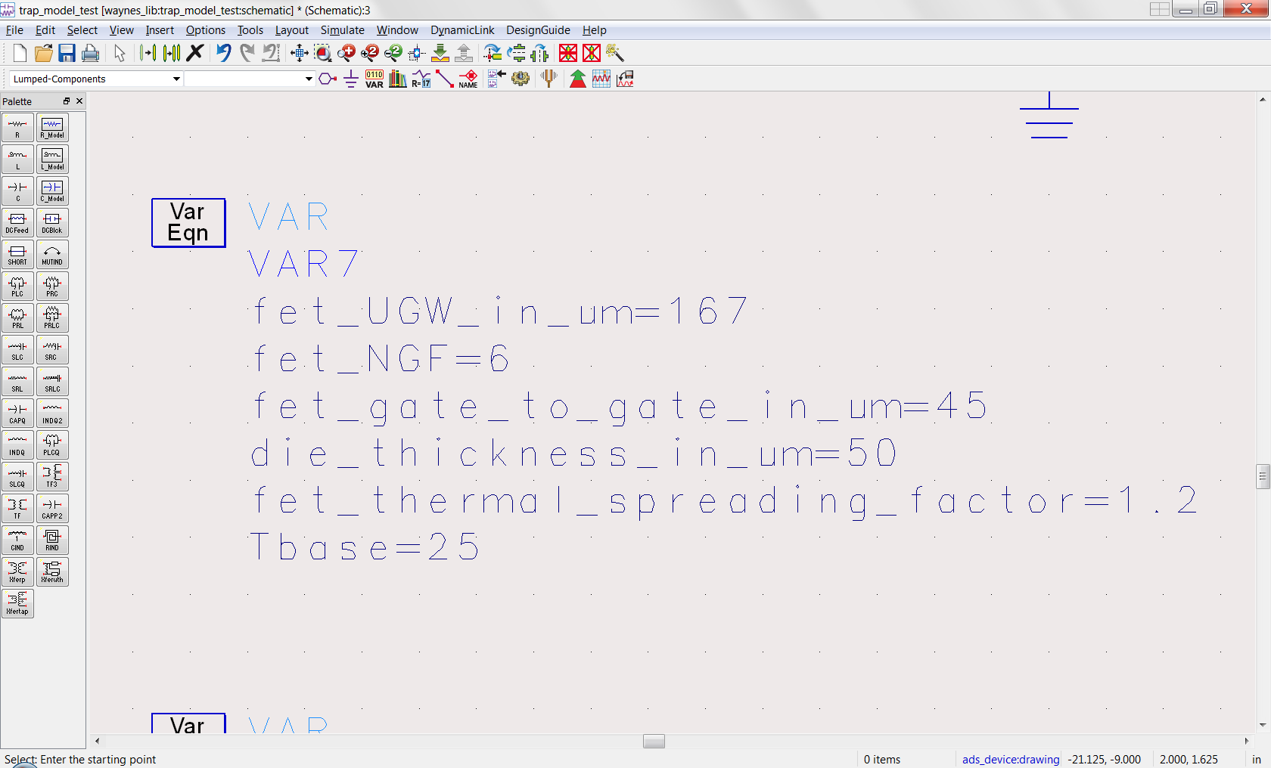
Jackal Model Verification (2.5GHz Loadpull 25ºC baseplate) GCS 0.4μm GaN on Silicon 6x167μm 50v HEMT (Vds=30v Ids=20mA)

Slide 49
Jackal Model Verification (2.5GHz Loadpull 25ºC baseplate) GCS 0.4μm GaN on Silicon 6x167μm 50v HEMT (Vds=30v Ids=20mA)
Pout Contours (dBm)
33-36dBm (0.5dB steps)
Pin=22dBm
PAE Contours (dBm)
35-60% (5% steps)
Pin=22dBm

Slide 50
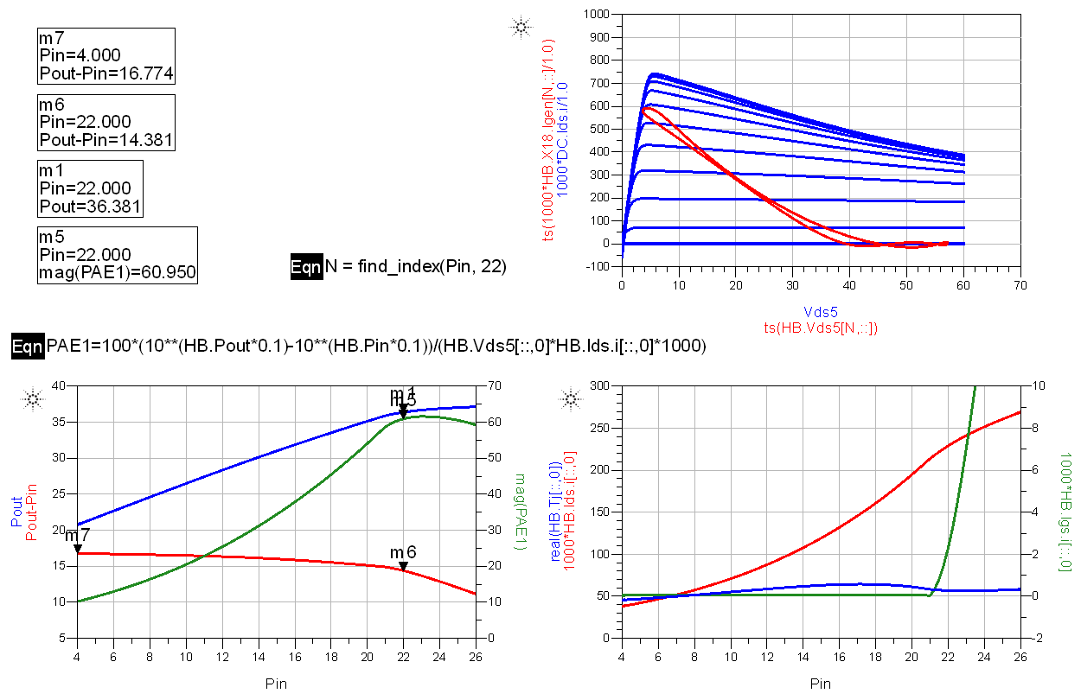
Jackal Model Verification (2.5GHz Loadpull 25ºC baseplate) GCS 0.4μm GaN on Silicon 6x167μm 50v HEMT (Vds=30v Ids=20mA)
Jackal Model
Simulation
Pout=36.4dBm
PAE=61.0%
Gain=14.4dB

Slide 51
Jackal Model Verification (2.5GHz Loadpull 25ºC baseplate) GCS 0.4μm GaN on Silicon 6x167μm 50v HEMT (Vds=30v Ids=20mA)
Measured Data
Pout=36.1dBm
PAE=58.6%
Gain=14.1dB

Slide 52
Jackal Model Verification (2.5GHz Loadpull 25ºC baseplate) GCS 0.4μm GaN on Silicon 6x167μm 50v HEMT (Vds=50v Ids=20mA)

Slide 53
Jackal Model Verification (2.5GHz Loadpull 25ºC baseplate) GCS 0.4μm GaN on Silicon 6x167μm 50v HEMT (Vds=50v Ids=20mA)
Pout Contours (dBm)
32-38dBm (1dB steps)
Pin=23dBm
PAE Contours (dBm)
30-55% (5% steps)
Pin=23dBm

Slide 54
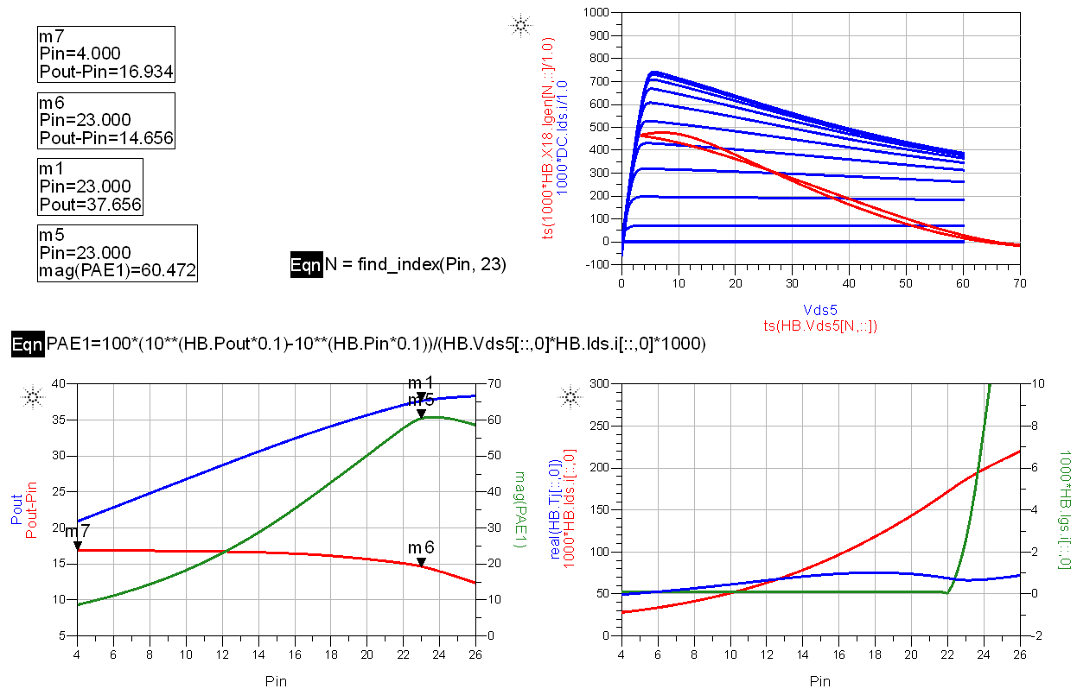
Jackal Model Verification (2.5GHz Loadpull 25ºC baseplate) GCS 0.4μm GaN on Silicon 6x167μm 50v HEMT (Vds=50v Ids=20mA)
Jackal Model
Simulation
Pout=37.7dBm
PAE=60.5%
Gain=14.7dB

Slide 55
Jackal Model Verification (2.5GHz Loadpull 25ºC baseplate) GCS 0.4μm GaN on Silicon 6x167μm 50v HEMT (Vds=50v Ids=20mA)
Measured Data
Pout=37.8dBm
PAE=58.4%
Gain=14.8dB

